Slide 1
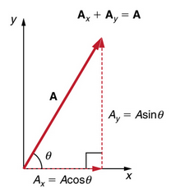
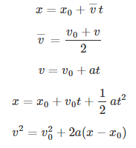
PHYS 111 Final Test formulas
Helpful math relationships
a² + b² = c²
a² + b² = c²

