Slide 1
Chapter 11: Contracts – Nature and Terminology
Miller

Slide 2
§1: Overview of Contract Law
Sources of Contract Law.
Common Law for all contracts except sales and leases.
Sale and lease contracts - Uniform Commercial Code (UCC). →

Slide 3
Overview of Contract Law
Function of Contract Law.
Provides stability and predictability for commerce.

Slide 4
Overview of Contract Law
Definition of a Contract.
Promise or set of promises,
For breach of which,
The law provides a remedy, or
The performance of which the law in some way recognizes as a duty.

Slide 5
Overview of Contract Law
Objective Theory of Contacts.
Circumstances to determine intent of parties.
Objective Facts include:
What a party said when entering into the contract,
How the party acted or appeared (intent may be inferred), and -->

Slide 6
Overview of Contract Law
Objective Theory of Contacts.
Objective Facts include:
Circumstances surrounding the transaction.
CASE 11.1 Pan Handle Realty, LLC v. Olins (2013).

Slide 7
§2: Elements of a Contract
Requirements:
Agreement (Offer and Acceptance).
Consideration: bargained-for-exchange.
Contractual Capacity. →

Slide 8
Elements of a Contract
Requirements:
Legality: purpose of contract must be legal at the time of execution.
Defenses to Enforceability:
Voluntary Consent.
Form: some types of contracts must be in writing.

Slide 9
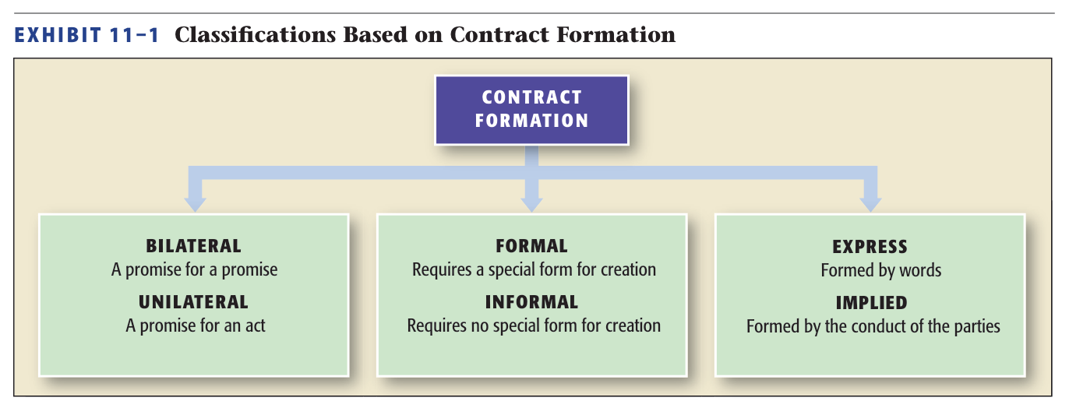
§3: Types of Contracts

Slide 10
Types of Contracts
Bilateral - Offeree must only promise to perform (“promise for a promise”). →

Slide 11
Types of Contracts
Unilateral - Offeree can accept the offer only by completing the contract performance (“a promise for an act”). Irrevocable: Offer cannot be revoked once performance has begun.

Slide 12
Types of Contracts
Formal versus Informal Contracts.
Formal: must be in writing to be enforceable.
Informal: all other contracts.

Slide 13
Types of Contracts
Express: Words (oral or written).
Implied (In Fact): Conduct creates and defines the terms of the contract. Requirements:
PL furnished good or service
PL expected to be paid
DEF had chance to reject and did not.

Slide 14
Types of Contracts
Contract Performance.
Executed - A contract that has been fully performed on both sides.
Executory - A contract that has not been fully performed on either side.

Slide 15
Types of Contracts
Contract Enforceability. →
Valid: agreement, consideration, contractual capacity, and legality.
Void: no contract.
Voidable (unenforceable).

Slide 16
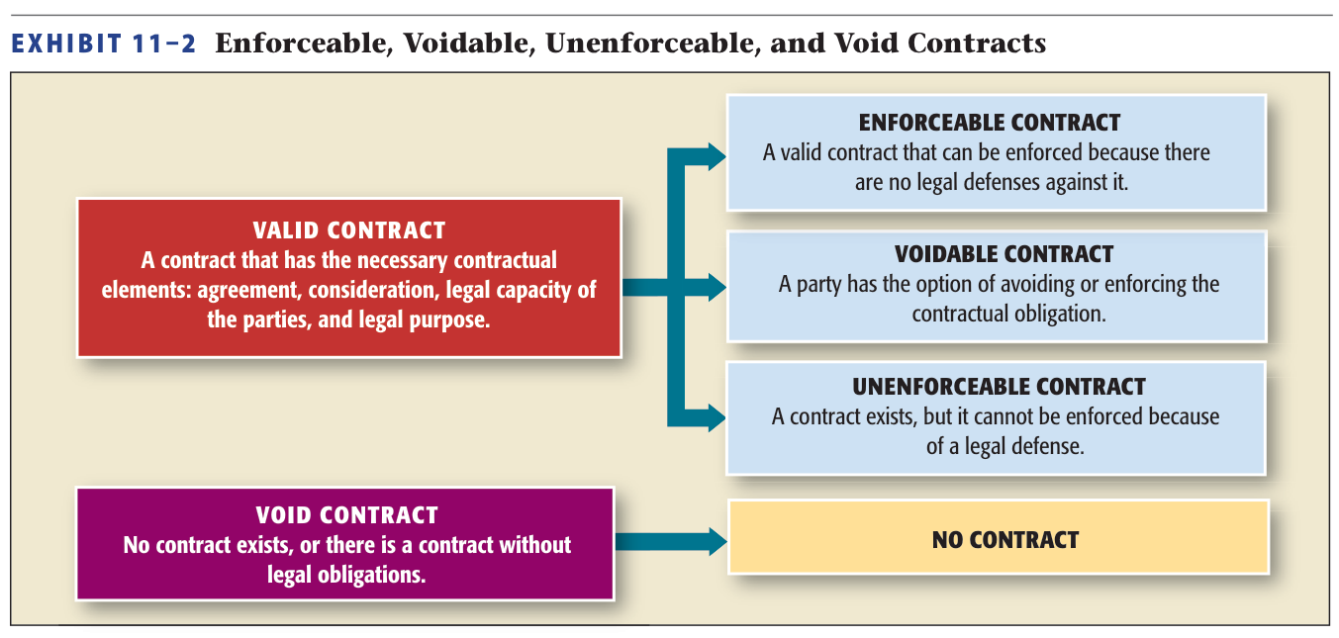
Contract Enforceability

Slide 17
§4: Quasi-Contracts
Quasi Contracts implied in law.
Equitable remedy created by courts, and imposed on parties in the interest of fairness and justice.→
Quantum Meruit.
CASE 11.2 Seawest Services Ass’n v. Copenhaver (2012).

Slide 18
Quasi-Contracts
Limitations on Quasi-Contractual Remedy:
Enriched party is not held liable in certain situations dealing with benefit is conferred unnecessarily, negligently or by misconduct. →

Slide 19
Quasi-Contracts
When an Actual Contract Exists: ordinarily there is no quasi-contract created at law.

Slide 20
§5: Interpretation of Contracts
“Plain Meaning” Rule.
Courts will will not admit “extrinsic” (external) testimony or evidence if meaning of contract terms are clear and unambiguous.→

Slide 21
Interpretation of Contracts
“Plain Meaning” Rule.
However, if terms are unclear or ambiguous, court may admit “extrinsic” (external) evidence.
CASE 11.3 Wagner v. Columbia Pictures Industries, Inc. (2004).

Slide 22
Interpretation of Contracts
Other Rules of Interpretation.
Contracts are interpreted as a whole.
Terms that are negotiated separately given greater weight.
Words given ordinary, common meaning.

Slide 23
Interpretation of Contracts
Other Rules of Interpretation.
Specific wording given greater weight than general language.
Written or typewritten given greater weight than preprinted.
Ambiguous terms interpreted against the drafter.

Slide 24
Interpretation of Contracts
Other Rules of Interpretation.
Trade usage, prior dealing, course of performance to allowed to clarify.

