Slide 1
Chapter 4: Business and the Constitution
Miller

Slide 2
§1: The Constitutional Powers of Government
Before the Revolutionary War, States wanted a confederation with weak national government and very limited powers. →

Slide 3
The Constitutional Powers of Government
After the war ended, the States voted to create a new, federal government that shared power with States.

Slide 4
The Constitutional Powers of Government
Federal Form of Government:
Shares power between national and state governments.
National government has limited, enumerated powers delegated from States.

Slide 5
The Constitutional Powers of Government
Regulatory Powers of States.
10th Amendment.
Police Powers: order, safety, morals.

Slide 6
The Constitutional Powers of Government
Relations Among the States.
Privileges and Immunities Clause.
Art. IV §2 of the U.S. Constitution.
Prevents state from imposing unreasonable burdens on citizens – particularly with regard to basic and essential activities.

Slide 7
The Constitutional Powers of Government
Relations Among the States.
Full Faith and Credit Clause (Art. IV §1).
Applies only to civil matters.
Ensures that any judicial decision with respect to such property rights will be honored and enforced in all states.

Slide 8
The Constitutional Powers of Government
Separation of Powers.
Federal government provides checks and balances:
Legislative (Congress): Creates laws.
Executive (President/Agencies): Enforce laws.
Judicial (Courts): Interpret laws.

Slide 9
The Constitutional Powers of Government
The Commerce Clause.
Power to regulate interstate commerce defined in Gibbons v. Ogden (1824): activities that “substantially affect interstate commerce.” →

Slide 10
The Constitutional Powers of Government
The Commerce Clause.
Expansion of Powers:
In 1942, Supreme Court expanded commerce clause to purely intrastate businesses (Wickard v. Filburn). →

Slide 11
The Constitutional Powers of Government
The Commerce Clause.
Expansion of Powers:
In 1964, Supreme Court prohibited racial discrimination in interstate commerce (Heart of Atlanta Motel v. U.S.).

Slide 12
The Constitutional Powers of Government
The Commerce Clause.
TODAY, the Commerce Clause authorizes the national government to regulate virtually any business enterprise, including the internet-based. Limits: U.S. v. Lopez (1995).

Slide 13
The Constitutional Powers of Government
The Commerce Clause.
Medical Marijuana.
Some states have laws that legalize marijuana for medical purposes.
Supreme Court held that use of medical marijuana does not insulate users from federal prosecution (2005).

Slide 14
The Constitutional Powers of Government
The “Dormant” Commerce Clause.
Generally, federal government has exclusive authority to regulate commerce that substantially affects trade among the states. →

Slide 15
The Constitutional Powers of Government
The “Dormant” Commerce Clause.
States possess inherent police powers to regulate health, safety, public order, morals and general welfare. →

Slide 16
The Constitutional Powers of Government
The “Dormant” Commerce Clause.
However, state police powers or regulations that substantially interfere with interstate commerce will be struck down. →

Slide 17
The Constitutional Powers of Government
The “Dormant” Commerce Clause.
CASE 4.1 Family Winemakers of California v. Jenkins (2010).

Slide 18
The Constitutional Powers of Government
The Supremacy Clause and Federal Preemption.
Article VI of the Constitution provides that the Constitution, laws, and treaties of the United States are the “Supreme Law of the Land.” →

Slide 19
The Constitutional Powers of Government
The Supremacy Clause and Federal Preemption.
In case of direct conflict between state and federal law, state law is invalid. →

Slide 20
The Constitutional Powers of Government
The Supremacy Clause and Federal Preemption.
A valid federal statute or regulation will take precedence over a conflicting state or local statute. →

Slide 21
The Constitutional Powers of Government
The Supremacy Clause and Federal Preemption.
Preemption occurs when Congress chooses to act exclusively when national and state governments have concurrent powers

Slide 22
The Constitutional Powers of Government
Taxing and Spending Powers.
Article I, Section 8: Congress has the “Power to lay and collect Taxes, Duties, Imposts, and Excises” which shall be “uniform” among the states.
Expansion of commerce clause gives taxing power as well.

Slide 23
§2: Business and the Bill of Rights
First Ten Amendments to the United States Constitution are called the Bill of Rights.
All apply to natural persons and most apply to business entities as well.

Slide 24
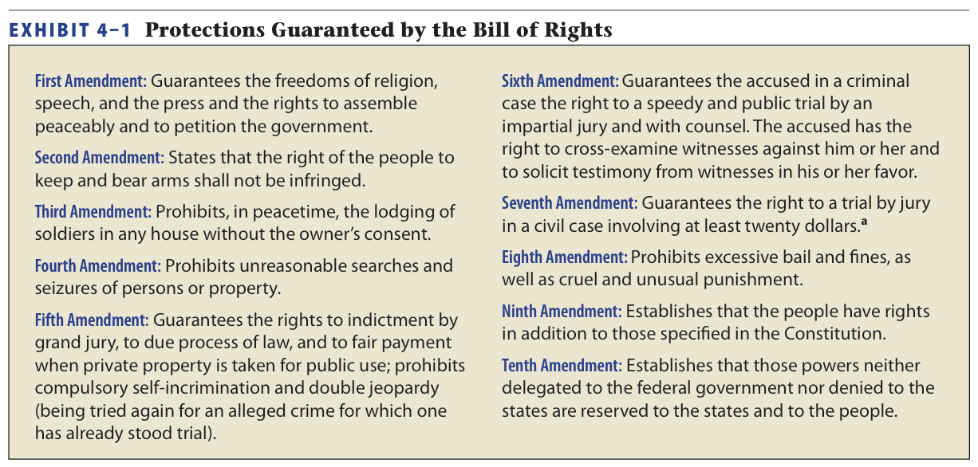
The Bill of Rights

Slide 25
Business and the Bill of Rights
Limits on Federal and State Actions.
Originally the Bill of Rights was a limit on the national government’s powers. →

Slide 26
Business and the Bill of Rights
Limits on Federal and State Actions.
Over time the Bill of Rights was “incorporated” to States via the due process clause of the 14th Amendment.
Rights are not absolute.→

Slide 27
Business and the Bill of Rights
Freedom of Speech.
Right to Free Speech is the basis for our democratic government.
Free speech also includes symbolic speech, including gestures, movements, articles of clothing.→
27

Slide 28
Business and the Bill of Rights
Freedom of Speech.
Reasonable Restrictions.
Balance between government’s obligation to protect, and citizen’s exercise of rights:
Content-Neutral Laws: aimed at combating some social problems. →
28

Slide 29
Business and the Bill of Rights
Freedom of Speech.
Laws that Restrict Content of Speech.
Laws that restrict content, must have a compelling state interest.
CASE 4.2 Doe v. Prosecutor, Marion County, Indiana (2013).
29

Slide 30
Business and the Bill of Rights
Freedom of Speech.
Corporate Political Speech.
In Citizens United v. Federal Election Commission (2010) the Supreme Court ruled that corporations can spend freely to support or oppose candidates for President and Congress.
30

Slide 31
Business and the Bill of Rights
Freedom of Speech.
Commercial Speech.
Courts give substantial protection to commercial speech (advertising).
Restrictions must: Implement substantial government interest; directly advance that interest; and go no further than necessary.→
31

Slide 32
Business and the Bill of Rights
Freedom of Speech.
Commercial Speech.
CASE 2.2 Bad Frog Brewery, Inc. v. New York State Liquor Authority (2003).
32

Slide 33
Business and the Bill of Rights
Freedom of Speech.
Unprotected Speech.
U.S. Supreme Court has held that certain speech is NOT protected: defamatory speech, threatening speech, and “fighting words. →
33

Slide 34
Business and the Bill of Rights
Freedom of Speech.
Unprotected Speech.
Obscene Speech: Miller v. California (1973), test for legal obscenity.
Online Obscenity: CDA (1996), COPA (1998), struck down by the Supreme Court. CIPA (2000) was upheld.
34

Slide 35
Business and the Bill of Rights
Freedom of Speech.
Unprotected Speech.
Virtual Pornography. In 2003, Congress passed the PROTECT Act, making it a crime to real and ‘virtual’ porn of children.
35

Slide 36
Business and the Bill of Rights
Freedom of Religion.
First Amendment may not “establish” a religion or prohibit the “free exercise” of religion.→
36

Slide 37
Business and the Bill of Rights
Freedom of Religion.
The Establishment Clause: prohibits government from establishing a state-sponsored religion, or passing laws that favor one over the other.
37

Slide 38
Business and the Bill of Rights
Freedom of Religion.
The Free Exercise Clause guarantees a person’s right to freely exercise her religion.
Employers must reasonably accommodate beliefs as long as employee has sincerely held beliefs.
38

Slide 39
Business and the Bill of Rights
Freedom of Religion.
The Free Exercise Clause:
Public Welfare Exception. When religious practices work against public policy and welfare, government can act in protecting the public.
39

Slide 40
Business and the Bill of Rights
Searches and Seizures.
The Fourth Amendment:
Requires search warrants to have “probable cause.”
General searches through personal belongings are illegal.
Search warrants must be specific.
40

Slide 41
Business and the Bill of Rights
Searches and Seizures.
The Fourth Amendment:
Generally business inspectors must have a warrant.
However, a warrantless search is permissible for seizure of spoiled or contaminated food.
41

Slide 42
Business and the Bill of Rights
Fifth Amendment.
Guarantees no person can be compelled to testify against himself in a criminal proceeding.
Does not apply to corporations or partnerships.
42

Slide 43
§3: Due Process and Equal Protection
Due Process.
Procedural Due Process: any government decision to take life, liberty or property must be fair.
Requires: Notice and Fair Hearing.
43

Slide 44
Due Process and Equal Protection
Due Process.
Substantive Due Process: focuses on the content (the right itself).
Fundamental Right: requires compelling state interest.
Non-Fundamental: rational relationship to state interest.
44

Slide 45
Due Process and Equal Protection
Equal Protection.
Government must treat similarly situated individuals (or businesses) in the same manner. →
45

Slide 46
Due Process and Equal Protection
Equal Protection.
Courts apply different tests:
Strict Scrutiny – fundamental rights.
Intermediate scrutiny.
“Rational Basis” Test -economic rights.
46

Slide 47
§4: Privacy Rights
Fundamental right not expressly found in the constitution, but derived from First, Fifth and Fourteenth Amendments.
Laws and policies affecting privacy are subject to the compelling interest test.

Slide 48
Privacy Rights
Federal Statutes Affecting Privacy Rights.
“Pretexting” for financial information is illegal under Gramm-Leach-Bliley.
Privacy Act of 1974.
HIPAA of 1996.
USA PATRIOT Act of 2001.

