Slide 1
Chapter 3: Court Procedures
Miller

Slide 2
Introduction
American and English court systems follow the adversarial system of justice.
Each client is represented by an attorney although a client is allowed to represent herself (called “pro-se”).

Slide 3
§ 1: Procedural Rules
Trials involve “due process” which requires adequate notice and a fair and impartial hearing.
For example, all civil trials in federal court are governed by the Federal Rules of Civil Procedure.

Slide 4
Procedural Rules
Stages of Litigation.
Pretrial.
Trial.
Posttrial.→

Slide 5
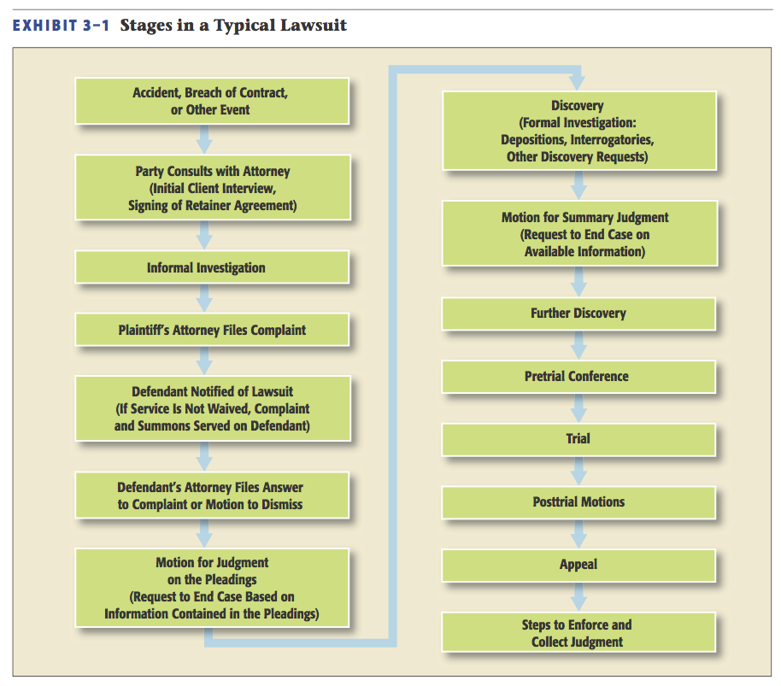
Stages in a Typical Lawsuit

Slide 6
Procedural Rules
Consulting an Attorney.
Generally, the first step.
Types of Attorneys’ Fees (hourly vs. contingent fee).
Settlement Considerations.

Slide 7
§ 2: Pre-Trial Procedures
Pleadings.
Discovery.
Conference
Jury Selection.

Slide 8
Pre-Trial Procedures
1st 2nd 3rd 4th Pleadings // Discovery // Conference // Jury

Slide 9
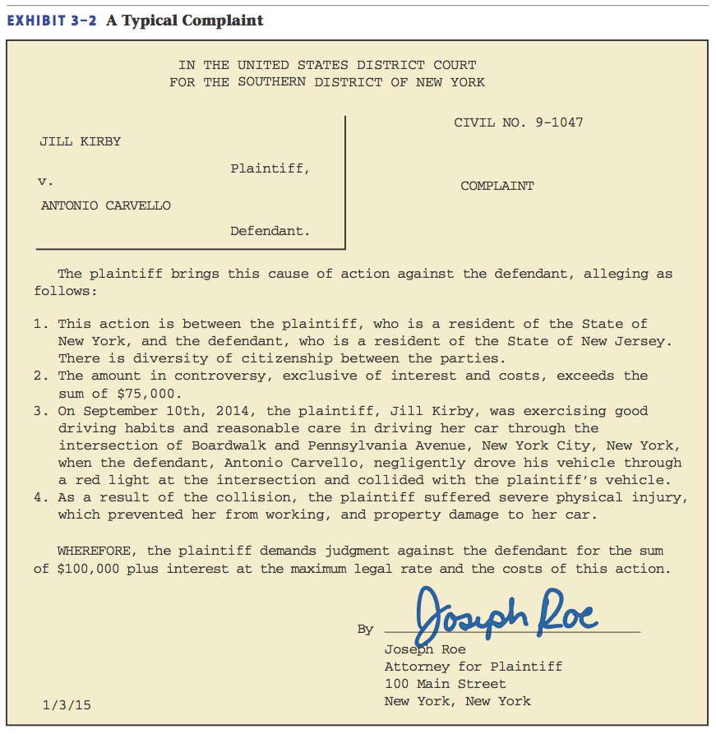
The Pleadings
Plaintiff’s Complaint.
Court acquires jurisdiction over subject matter and Plaintiff.
Facts.
Prayer for Court Relief.

Slide 10
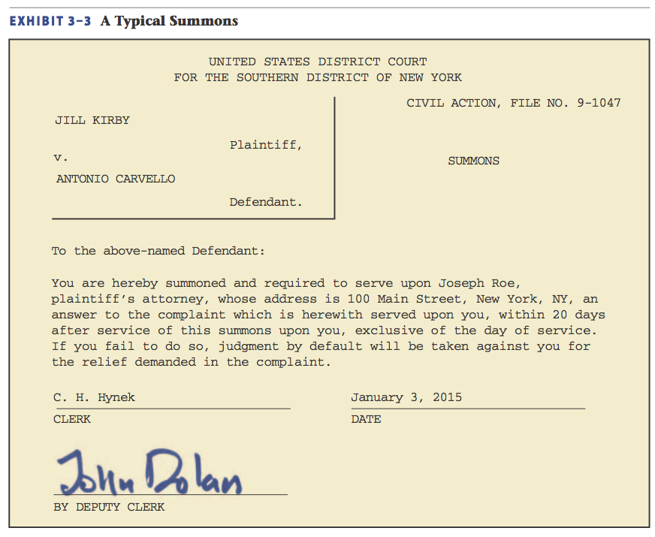
The Pleadings
Service of Process.
Plaintiff serves Defendant with Complaint and Summons.
Default Judgment for Plaintiff, if Defendant does not Answer.

Slide 11
Pleadings
Method of Service.
Usually by Sheriff or private process server. Copy of Complaint and Summons personally delivered.
If Defendant cannot be reached, “Notice by Publication” is allowed in local newspaper of record.

Slide 12
Pleadings
Method of Service.
Corporate Defendants served via Registered Agent. If the Defendant is out-of-state, Court can acquire jurisdiction by “long-arm” statutes.
Waiver of Service.

Slide 13
Pleadings
Defendant’s Response.
The Answer is the Defendant’s response to the allegations stated in the Plaintiff’s Complaint.
In the Answer, the Defendant must specifically admit or deny each allegation in the Complaint.
Notes:
5

Slide 14
Pleadings
Defendant’s Response.
Makes General Denial.
May move for Change of Venue.
May allege Affirmative Defenses. →
May assert Counterclaims against Plaintiff. →
Notes:
5

Slide 15
Pleadings
Defendant’s Response.
Affirmative Defense: burden is on defendant to introduce proof.
Counterclaims: defendant sues plaintiff, and plaintiff answers.
Notes:
5

Slide 16
Pleadings
Dismissals and Pre-Trial Judgments.
Many lawsuits never go to trial.
Perhaps there is a settlement.
Perhaps the case was dismissed.→
Notes:
5

Slide 17
Pleadings
Dismissals and Pre-Trial Judgments.
Parties often file “Pre-Trial Motions” asking the Court to do something.
Motions must be filed and served on the other party.→
Notes:
5

Slide 18
Pleadings
Dismissals and Pre-Trial Judgments.
Motion to Dismiss: either party (normally defendant) can ask the court to dismiss the case if the pleadings fail to show a legal claim.→
Notes:
5

Slide 19
Pleadings
Dismissals and Pre-Trial Judgments.
Motion to Dismiss.
Case 3.1 Espresso Disposition Corp. 1 v. Santana Sales & Marketing Group, Inc. (2013).
Notes:
5

Slide 20
Pleadings
Dismissals and Pre-Trial Judgments.
Motion for Judgment on the Pleadings: court decides.
Motion for Summary Judgment: no genuine issue of material fact.
Notes:
5

Slide 21
Pleadings
Dismissals and Pre-Trial Judgments. →
Motion for Summary Judgment.
Asks a court to grant a judgment for moving party without a trial.
Facts are viewed in the light most favorable to the other party.
Admissible evidence is submitted: affidavits, documents, contracts, emails.
Notes:
5

Slide 22
Pretrial Motions: Summary

Slide 23
Pre-Trial Procedures
1st 2nd 3rd 4th Pleadings // Discovery // Conference // Jury

Slide 24
Pre-Trial: Discovery
Discovery is the process by which parties obtain information from the opposing party prior to trial.
Case 3.2 Blankenship v. Collier (2010).

Slide 25
Pre-Trial: Discovery
Discovery Rules.
Depositions: sworn testimony recorded and transcribed by court official (court reporter).

Slide 26
Pre-Trial: Discovery
Interrogatories: written questions and answers under oath.
Requests for Admissions: admission is considered a “fact” for trial. →

Slide 27
Pre-Trial: Discovery
Requests for Documents, Objects, and Entry Upon Land.
Requests for Examination.

Slide 28
Pre-Trial: Discovery
E-Discovery Procedures.
FRCP deals specifically with preservation, retrieval, and production of electronic data.

Slide 29
Pre-Trial Procedures
1st 2nd 3rd 4th Pleadings // Discovery // Conference // Jury

Slide 30
Pretrial Conference
After discovery is completed meet with trial judge.
Explore possibility of settlement, or identify issues that are in dispute for jury to consider.

Slide 31
Pre-Trial Procedures
1st 2nd 3rd 4th Pleadings // Discovery // Conference // Jury

Slide 32
The Jury
Right to Jury Trial is guaranteed by Seventh Amendment to U.S. Constitution. →

Slide 33
The Jury
Jury Selection.
Voir Dire.
Jurors can be dismissed peremptorily (no reason or for cause (bias).

Slide 34
§ 3: The Trial
Opening Statements.
Rules of Evidence.
Judge decides what evidence is admissible for jury’s consideration.
Evidence must be relevant to the issues (tends to prove or disprove).

Slide 35
The Trial
Examination of Witnesses.
Expert Witnesses. Provide specialized knowledge and opinions that help jurors decide issues.
Case 3.3 Downey v. Bob’s Discount Furniture Holdings, Inc. (2011).

Slide 36
The Trial
Motion for Directed Verdict.
At conclusion of plaintiffs’ case.
Court looks at evidence in most favorable light to defendant.
Defendant’s Evidence.
Plaintiff can ‘rebut’ the evidence, and defense can state ‘rejoinders.’

Slide 37
The Trial
Closing Arguments, Jury Instructions, and Verdict.
After both sides present their cases, the attorneys make their closing statements. Each attorney summarizes the facts and evidence and tells her client’s story in the most compelling way possible.

Slide 38
The Trial
Closing Arguments, Jury Instructions, and Verdict.
Jury Instructions:
After closing arguments, the judge instructs the jury on the law of the case. →

Slide 39
The Trial
Closing Arguments, Jury Instructions, and Verdict.
Jury Instructions:
Criminal cases--burden of proof is “beyond a reasonable doubt” and the verdict (for guilty or acquittal) must be unanimous. If not, mistrial/hung jury.

Slide 40
The Trial
Closing Arguments, Jury Instructions, and Verdict.
Jury Instructions:
Civil Cases—generally, burden of proof is by “preponderance” of the evidence and a majority of jurors must agree on verdict. If not, then mistrial/ hung jury.

Slide 41
The Trial
Closing Arguments, Jury Instructions, and Verdict.
Verdict:
The verdict specifies the jury’s findings and liability.
Jury can award money damages in a civil case, or prison in criminal case.
Jury is dismissed after verdict.

Slide 42
§ 4: Posttrial Motions
After jury reaches a verdict, either party can make a posttrial motion.
Motion for New Trial: after looking at all the evidence, judge will grant the motion IF the jury was in error. →

Slide 43
Posttrial Motions
After jury reaches a verdict, either party can make a posttrial motion.
Motion for J.N.O.V. : granted only if the jury’s verdict was unreasonable and erroneous.

Slide 44
§ 5: The Appeal
A party may appeal the jury’s verdict or any legal issue, motion or court ruling during the trial.
Appellants must have legitimate grounds for appeal (usually legal error).→

Slide 45
The Appeal
Filing the Appeal.
The Appellant files a brief that contains a short statement of the facts, issues, rulings by the trial court, grounds to reverse the judgment, applicable law and arguments on Appellant’s behalf.

Slide 46
The Appeal
Appellate Review.
Appeals court can affirm (agree with) or reverse (disagree with) the lower court’s decision.

Slide 47
§ 6: Enforcing the Judgment
Requesting Court Assistance in Collecting the Judgment.
Writ of Execution: directs sheriff to seize defendant’s non-exempt property and sell them to pay for judgment. →

Slide 48
Enforcing the Judgment
Availability of Assets.
Usually a plaintiff looks to see if the defendant has sufficient assets before the suit is filed.

