Slide 1
Chapter 2: Courts and Alternative Dispute Resolution
Miller 

Slide 2
§1: The Judiciary’s Role In American Government
Judicial Review was established by the U.S. Supreme Court in Marbury v. Madison (1803) where Chief Justice Marshall wrote:
“It is emphatically the province and duty of the judiciary to say what the law is….”
2

Slide 3
§2: Basic Judicial Requirements
Jurisdiction:
“Juris” (law) “diction” (to speak) is the power of a court to hear a dispute and to “speak the law” into a controversy and render a verdict that is legally binding on the parties to the dispute.
3

Slide 4
Jurisdiction
Over Persons:
Power of a court to compel the presence of the parties (including corporations) to a dispute to appear before the court and litigate.
4

Slide 5
Jurisdiction
Over Property (In Rem):
A court has power to decide issues relating to property, whether the property is real, personal, tangible, or intangible. →
5

Slide 6
Jurisdiction
Over Property (In Rem):
A court generally has in rem jurisdiction over any property situated within its geographical borders.
6

Slide 7
Jurisdiction
Long Arm Statutes:
Courts use long-arm statutes for non-resident parties based on “minimum contacts” with state. Means defendant had some connection with forum state.
7

Slide 8
Jurisdiction
Corporate Contacts:
Courts use same principles as for a natural persons?
Minimum Contacts? Example: does a business actively advertise within a state?
8

Slide 9
Subject Matter Jurisdiction
General and Limited Jurisdiction.
Statutory limitation on the types of cases a court can hear, usually determined by federal or state statutes. (Example: probate, bankruptcy, criminal.)
9

Slide 10
Original and Appellate Jurisdiction
Courts of original jurisdiction is where the case started (trial).
Courts of appellate jurisdiction have the power to hear an appeal from another court.
10

Slide 11
Federal Court Jurisdiction
“Federal Question” cases:
Rights or obligations of a party are created or defined by some federal law. →
11

Slide 12
Federal Court Jurisdiction
“Diversity of Citizenship”
Parties are not from the same state, and
The amount in controversy is greater than $75,000.
Case 2.1 Mala v. Crown Bay Marina, Inc. (2013).
12

Slide 13
Exclusive vs. Concurrent Jurisdiction
Exclusive: only one court (state or federal) has the power (jurisdiction) to hear the case.
Concurrent: more than one court can hear the case.
13

Slide 15
Jurisdiction in Cyberspace
Courts use a “Sliding Scale” Standard to determine whether to exercise jurisdiction.
Some Interaction
Substantial Business Interaction
Passive Website
No Yes
15

Slide 16
Jurisdiction in Cyberspace
International Jurisdiction Issues.
How do courts apply the “sliding scale” to international cases?
Case 2.2 Gucci America, Inc. v. Wang Huoqing (2011).
16

Slide 17
Venue
Venue is concerned with the most appropriate location for the trial.
Generally, proper venue is whether the injury occurred.
17

Slide 18
Standing to Sue
A party must have suffered a legal injury and have a sufficient “stake” in the controversy.
18

Slide 19
§3: State and Federal Court Systems
Texas Courts
Federal Courts
Ct. Criminal
Appeals
Supreme
Court
U.S. Supreme
Court
Court of
Appeals
Circuit
Courts of
Appeals
District Court
County Court
Municipal
Court
Justice
Court
U.S. District
Court
19

Slide 20
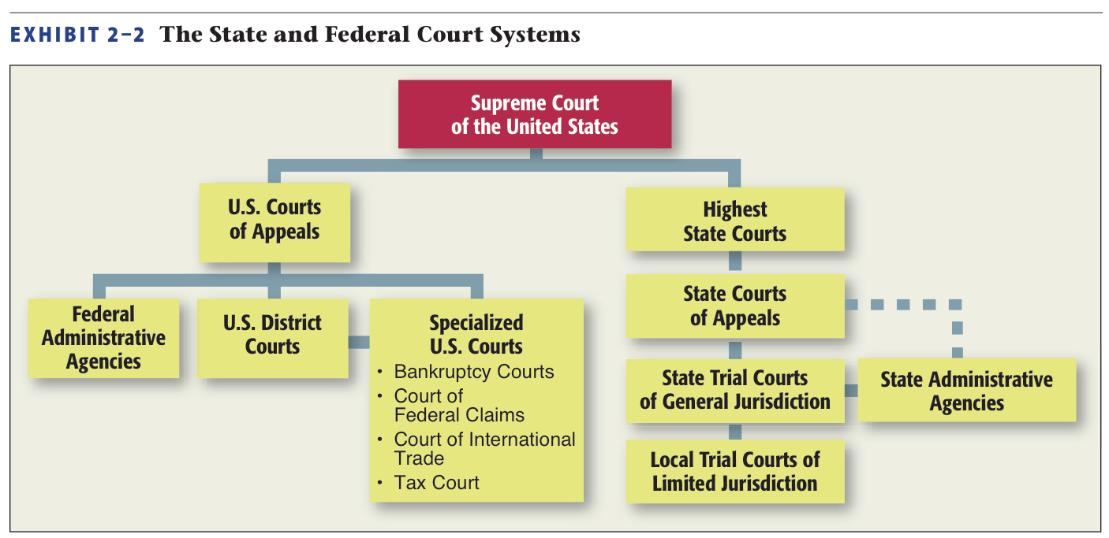
Federal Court Systems
20

Slide 21
State Courts
Trial Courts.
General Jurisdiction.
“Courts of record” (with court reporters).
Usually have jurisdiction over both civil and criminal cases.
21

Slide 22
State Courts
Limited Jurisdiction.
Small Claims Courts: informal, inferior courts with limited amounts in controversy (usually $5,000).
22

Slide 23
State Courts
Appellate, or Reviewing, Courts.
Review trial courts proceedings to determine whether the trial was according to the procedural and substantive rules of law.
Usually only hear questions of law, not fact (which are usually determined by juries).
23

Slide 24
State Courts
Highest State Courts.
Usually called the supreme court of that state (but in New York and Maryland, called the Court of Appeals).
As far as state law is concerned the state supreme court decision is final.
24

Slide 25
Federal Courts
Basically three-tiered system:
U.S. District Courts.
U.S. Courts of Appeal.
The United States Supreme Court.
25

Slide 26
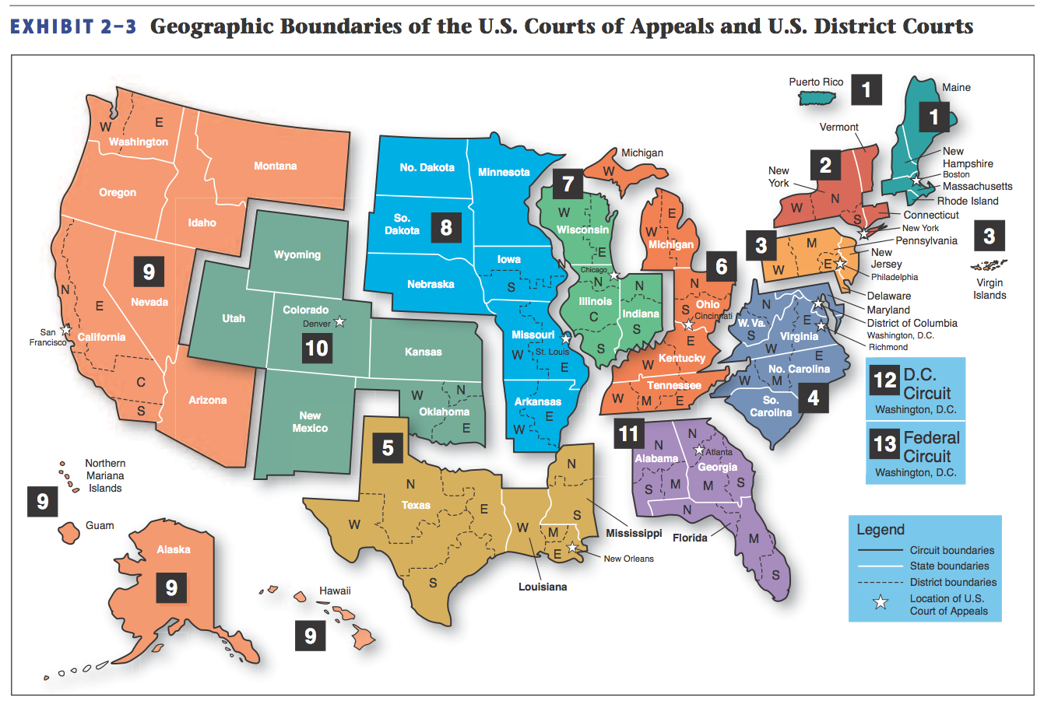
Boundaries of U.S. Courts of Appeal
26

Slide 27
The U.S. Supreme Court
The U.S. Supreme Court hears cases in its discretion.
In other words, it must grant a Writ of Certiorari for Court to hear a case. →
27

Slide 28
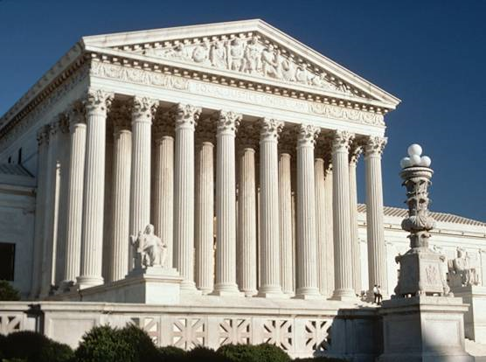
The U.S. Supreme Court
www.supremecourt.gov
28

Slide 29
§4: Alternative Dispute Resolution
Trials are very expensive and sometimes take many months to resolve.
ADR methods are inexpensive, relatively quick, and give parties more control over process.
29

Slide 30
ADR
Unless court-ordered, there is no record which is an important factor in commercial litigation due to trade secrets.
Most common: negotiation, mediation, arbitration.
30

Slide 31
Negotiation
Informal, sometimes without attorneys, where differences are discussed with the goal of “meeting of the minds” in resolving the case. →
31

Slide 32
Negotiation
Successful negotiation involves thorough preparation, from a position of strength.
32

Slide 33
Mediation
Involves neutral 3rd party ‘mediator’.
Mediator talks face-to-face with parties (in different rooms) to determine “common ground.” →
33

Slide 34
Mediation
Advantages: few rules, customize process, parties control results (win-win).
Disadvantages: mediator fees, no sanctions or deadlines.
34

Slide 35
Arbitration
Neutral 3rd party can render a legally-binding decision; usually an expert or well-respected government official.
35

Slide 36
Arbitration
Disadvantages:
Results unpredictable because arbitrators are not required to follow precedent or rules of procedure or evidence.
No written opinions.
Generally, no discovery.
36

Slide 37
Arbitration
Process.
Case begins with a submission to an arbitrator.
Next comes the hearing where parties present evidence and arguments. Finally, the arbitrator renders an award. →
37

Slide 38
Arbitration
Process.
Courts are not involved in arbitration unless an arbitration clause in a contract needs enforcement.
38

Slide 39
Arbitration
Arbitrator’s Decision.
Decision is called an award.
Usually final, courts will only review if evidence of:
Arbitrator’s bad faith.
Award violates public policy.
Arbitrator exceeded her powers.
39

Slide 40
Arbitration
Arbitration Clauses.
Almost any commercial matter can be submitted to arbitration.
Usually this is done with an arbitration clause in a contract (see Chapter 11 on Contracts).
40

Slide 41
Arbitration
Arbitration Statutes.
Uniform Arbitration Act of 1955.
Federal Arbitration Act.
CASE 2.3 Cleveland Construction, Inc. v. Levco Construction, Inc. (2012).

Slide 42
Arbitration
Issue of Arbitrability.
No party will be compelled to arbitration unless a court finds the party consented, and that they are fair to both parties.

Slide 43
Arbitration
Mandatory Arbitration in the Employment Context.
Generally clauses are enforceable.
Gilmer decision (1991).
Arbitrators do not have to follow precedent or rules of procedure or evidence. →

Slide 44
Arbitration
Mandatory Arbitration in the Employment Context.
Private Arbitration Proceedings.

Slide 45
Alternate Dispute Resolution
Other Types of ADR.
Assisted Case Evaluation.
Mini-Trial.
Binding mediation.
Summary Jury Trial.

Slide 46
Alternate Dispute Resolution
Providers of ADR Services.
American Arbitration Association.
Hundreds of for-profit firms provide ADR services.
Retired judges.

Slide 47
Online Dispute Resolution
Also called ODR.
Uses the Internet to resolve disputes.
Still in its infancy but is gaining momentum.
See, e.g., www.cybersettle.com.

Slide 48
§ 5: International Dispute Resolution
Forum Selection and Choice-of-Law clauses in contracts govern the transaction.
Arbitration clauses are generally incorporated into international contracts.
48

