Slide 1
Chapter 1: Introduction to Law and Legal Reasoning
Miller

Slide 2
§1: Business Activities and the Legal Environment
Laws and regulations affect virtually all business activities.
Knowledge of ‘black-letter’ not enough - business now assumes an ethical dimension.
Many different laws may affect a single business transaction. →
2

Slide 3
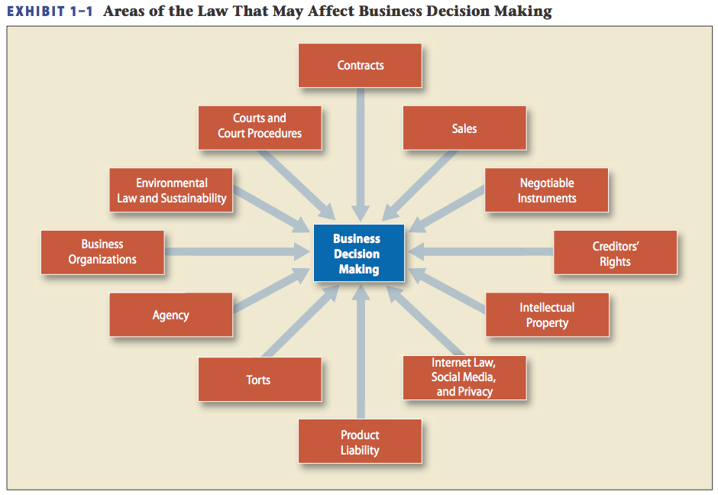
3

Slide 4
§2: Sources of American Law
Constitutional Law.
Statutory Law.
Ordinances.
Uniform Laws (NCCUSL).
Uniform Commercial Code.
© 2011 Cengage Learning. All Rights Reserved. May not be copied, scanned, or duplicated, in whole or in part, except for use as permitted in a license distributed with a certain product or service or otherwise on a password-protected website for classroom use.
4

Slide 5
Sources of American Law
Administrative Law.
Federal Agencies.
State and Local Agencies.
Case Law and Common Law Doctrines.
5

Slide 6
§3: The Common Law Tradition
American law is based largely on English Common Law which was based largely on traditions, social customs, rules, and cases dating back to 1066 A.D.
6

Slide 7
The Common Law Tradition
Early English Courts: at common law, there were two separate court systems:
COURTS OF LAW (monetary relief), and
COURTS OF EQUITY (non-monetary relief) based on “notions of justice and fair dealing.” →
7

Slide 8
Courts of Law
Also called “king’s courts”: judges were appointed by the king.
Remedies limited to those provided at law, i.e., land, chattel, money. →
8

Slide 9
Courts of Law
Judges resolved disputes by application of rules of law to the facts of the case before the court.
9

Slide 10
Courts of Equity
Equity is branch of law founded on what is fair and just.
Courts of equity were administered by chancellors appointed by the king. →
10

Slide 11
Courts of Equity
Equitable remedies include: specific performance, injunctions, rescissions.
11

Slide 12
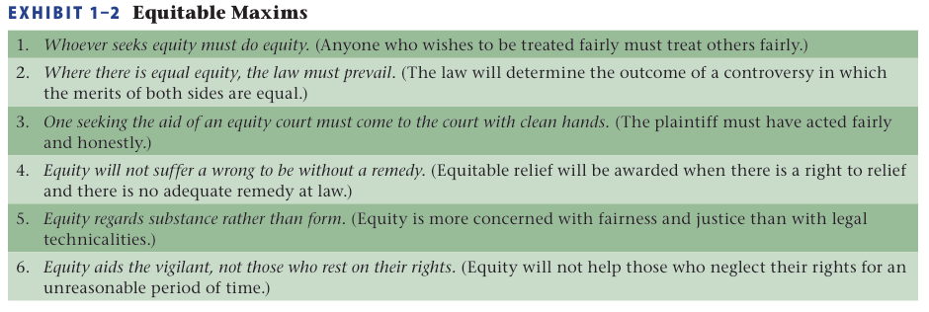
Equitable Maxims
12

Slide 13
Legal and Equitable Remedies Today
Federal and state courts have consolidated remedies at law and equity.
Generally, the same court order includes both damages and equitable or injunctive relief.
13

Slide 14
Stare Decisis
Stare Decisis (“stand on decided cases”) is judge-made law.
Case Precedents & Reporters.
Each decision and interpretation becomes a legal precedent. →
14

Slide 15
Stare Decisis
Case Precedents & Reporters.
Cases are now published in national and regional “Reporters” (discussed later in Chapter 1).
15

Slide 16
Stare Decisis
Stare Decisis and the Common Law Tradition.
Courts are obliged to follow precedents within their jurisdictions.
Courts should not overturn their own precedents without compelling reasons. →
16

Slide 17
Stare Decisis
Controlling Precedents.
Referred to as “binding authorities.”
Include the Constitution, Supreme Court cases, federal appellate cases, federal and state statutes.
17

Slide 18
Stare Decisis
Stare Decisis and Legal Stability.
Stare decisis helps courts be more efficient and makes the law more predictable.
18

Slide 19
Stare Decisis
Departures from Precedent.
In cases of “first impression” where there is no precedent, the court may refer to positive law, public policy, and widely held social values in order to craft the best new precedent. →
19

Slide 20
Stare Decisis
When There is No Precedent.
Called cases of “first impression.”
Courts look at persuasive authorities, legal principles, policies, as well as fairness, and the social context.
20

Slide 21
Stare Decisis and Legal Reasoning
Basic Steps (IRAC format):
Key Facts and Issues (What are the questions to be answered?)
Rules (What laws governs this matter?) →
21

Slide 22
Stare Decisis and Legal Reasoning
Basic Steps (IRAC format):
Application (How do the rules of law apply to these facts?)
Conclusion (Decision or Verdict)
22

Slide 23
There is No One “Right” Answer
Good arguments are made for different sides.
Judges have personal beliefs that can affect decisions.
Outcomes to lawsuits cannot be predicted with certainty.
23

Slide 24
The Common Law Today
Common law governs transactions not covered by statutory law.
Courts Interpret Statutes. →
24

Slide 25
The Common Law Today
Restatements of the Law.
Summarize the common law of most states.
Published by the American Law Institute.
25

Slide 26
§4: Schools of Legal Thought
Natural Law School.→
Positivist School.→
Historical School.→
Legal Realism.→
26

Slide 27
The Natural Law School
Assumes law, rights and ethics are based on universal moral principals inherent in nature discoverable through human reason. →
27

Slide 28
The Natural Law School
The oldest view of jurisprudence dating back to Aristotle.
The Declaration assumes natural law, or what Jefferson called “the Laws of Nature.” →
28

Slide 29
Natural Law: Rev. Martin Luther King, Jr.
Letter from the Birmingham Jail, April 16, 1963. “[T]here are two types of laws: just and unjust laws. . . . A just law is a man-made code that squares with the moral law . . . . An unjust law is a code that is out of harmony with the moral law. . . . An unjust law is a human law that is not rooted in eternal and natural law.”
29

Slide 30
The Positivist School
Law is the supreme will of the State that applies only to the citizens of that nation at that time. →
30

Slide 31
The Positivist School
Law, and therefore rights and ethics, are not universal. The morality of a law, or whether the law is “bad or good,” is irrelevant.
31

Slide 32
The Historical School
Emphasizes the evolutionary process of law.
Concentrates on the origins of the legal system.→
32

Slide 33
The Historical School
Law derives its legitimacy and authority from standards that have withstood the test of time.
33

Slide 34
Legal Realism
Holds that law is not simply a result of the written law, but a product of the views of judicial decision makers, as well as social, economic, and contextual influences.
34

Slide 35
§5: Classifications of Law
Every type of law will be either:
Civil or Criminal. →
Substantive or Procedural. →
Public or Private.
35

Slide 36
Substantive vs. Procedural
Substantive law defines or creates the rights and obligations of persons and governments. →
36

Slide 37
Substantive vs. Procedural
Procedural law provides the steps one must follow in order to avail oneself of one’s legal rights or enforce another’s legal obligations.
37

Slide 38
Civil vs. Criminal
Civil law defines the rights between individuals or individuals and governments.
Criminal law defines an individual’s obligations to society as a whole.
38

Slide 39
CyberLaw
Not really a new type of law, but traditional legal rules applied to online transactions.
Applies to just about all legal issues, including copyright, contracts, banking, etc.
39

Slide 40
§6: How to Find Primary Sources of Law
Citation: identifies a legal publication in which legal authority is found.
Finding Statutory Law and Administrative Law.
United States Code (USC). www.gpoacess.gov/uscode →
40

Slide 41
§6: How to Find Primary Sources of Law
Finding Statutory Law and Administrative Law.
State Codes.
Administrative Rules.
41

Slide 42
How to Find Primary Sources of Law
Finding Case Law.
State Court Decisions.
Regional Reporters.
Case Citations. →
42

Slide 43
How to Find Primary Sources of Law
Finding Case Law.
Federal Court Decisions.
United States Supreme Court decisions are published by the federal government in United States Reports (U.S.). The U.S. Supreme Court website is www.supremecourt.gov
43

Slide 44
§7: How to Read & Understand Case Law
Legal cases are identified by a “legal citation” (or a “cite”) as the sample below:
Apple, Inc. v. Amazon.com, Inc., __F.Supp.2d__, 2013 WL 11896 (2013).
Title: First Party is Plaintiff, second party is Defendant. The parties are either italicized or underlined.
44

Slide 45
§7: How to Read & Understand Case Law
Legal cases are identified by a “legal citation” (or a “cite”) as the sample below:
Apple, Inc. v. Amazon.com, Inc., __F.Supp.2d__, 2013 WL 11896 (2013).
This is a federal court case in 2013. It is due to be published in the Federal Supplement 2nd. In the meantime it is found on Westlaw, document # 11896.
45

