Slide 1
Chapter 6: Torts
Miller

Slide 2
§1: Basis of Tort Law
Doing business today involves risks, both legal and financial.
A tort is a civil injury designed to provide a remedy (damages) for injury to a protected interest. →

Slide 3
Basis of Tort Law
Damages Available in Tort Actions.
Compensatory: reimburse plaintiff for actual losses.
Special: quantifiable losses, such as medical expenses, lost wages, and benefits. →

Slide 4
Basis of Tort Law
Damages Available in Tort Actions.
General: non-monetary, such as pain and suffering, reputation.
Punitive: punish the wrongdoer.

Slide 5
Basis of Tort Law
Tort Reform.
Types of Reforms.
Limit punitive and general damages.
Capping what attorneys receive in contingency cases.
Losing party pays all expenses.
Federal Reform.
State Reforms.

Slide 6
§2: Intentional Torts Against Persons
Tortfeasor (person committing the tort) must “intend” to commit the act:
He intended the consequences of his act; or
He knew with substantial certainty that certain consequences would result. →

Slide 7
Intentional Torts Against Persons
Transferred Intent.
Intent of tortfeasor is transferred when he intends to harm person “A” but unintentionally harms person “B” as well.

Slide 8
Intentional Torts Against Persons
Assault and Battery. →
False Imprisonment. →
Infliction of Emotional Distress. →
Defamation. →
Invasion of Privacy. →
Business Torts. →

Slide 9
Intentional Torts Against Persons
Assault.
Intentional, unexcused act that:
Creates a reasonable apprehension or fear of,
Immediate harmful or offensive contact.
NO CONTACT NECESSARY. →

Slide 10
Intentional Torts Against Persons
Battery is the completion of the Assault:
Intentional or Unexcused.
Harmful, Offensive (Reasonable Person Standard) or Unwelcome.
Physical Contact.
Plaintiff may be compensated for physical and emotional harm.

Slide 11
Intentional Torts Against Persons
False Imprisonment.
Confinement or restraint.
Of another person’s activities.
Without justification.
Merchants may reasonably detain customers if there is probable cause.

Slide 12
Intentional Torts Against Persons
Intentional Infliction of Emotional Distress.
Extreme and outrageous,
Results in severe emotional distress in another.
Most courts require some physical symptom or illness.

Slide 13
Intentional Torts Against Persons
Defamation.
Defamation involves wrongfully hurting a person’s good reputation.
Law imposes duty to refrain from making false statements of fact about others. →

Slide 14
Intentional Torts Against Persons
Defamation.
Orally breaching this duty is slander; breaching it in print or media (and internet) is libel. →

Slide 15
Intentional Torts Against Persons
Defamation.
Published statement must be a fact. Opinions are protected speech under the First Amendment, and not actionable. →

Slide 16
Intentional Torts Against Persons
Defamation.
Publication Requirement: gravamen of defamation is the “publication” of a false statement to a 3rd party that holds an individual up to hatred, contempt or ridicule in the community. →

Slide 17
Intentional Torts Against Persons
Defamation: Libel.
General Damages are presumed; Plaintiff does not have to prove actual injury.
Include compensation for disgrace, dishonor, humiliation, injury to reputation and emotional distress.

Slide 18
Intentional Torts Against Persons
Defamation: Slander.
General Rule: Proof of “Special damages” (actual economic loss).
Exception: Slander Per Se. No proof of damages is necessary when the statement involves: loathsome disease, business improprieties, serious crime, or that a woman is non-chaste.

Slide 19
Intentional Torts Against Persons
Defamation: Defenses.
Truth is generally an absolute defense.
Privileged (or Immune) Speech.
CASE 6.1 McKee v. Laurion (2013).→

Slide 20
Intentional Torts Against Persons
Defamation: Defenses.
Public Figures.
To prevail against a public figure, plaintiff must show the statement was made with “actual malice” (made with either knowledge of falsity or reckless disregard for the truth).

Slide 21
Intentional Torts Against Persons
Invasion of Privacy.
Use of Person’s Name or Likeness.
Intrusion on Individual’s Affairs or Seclusion.
Publication of Information that Places a Person in False Light.
Public Disclosure of Private Facts.

Slide 22
Intentional Torts Against Persons
Invasion of Privacy.
Use of another’s name, likeness or other identifying characteristic for commercial purposes without the owner’s consent.

Slide 23
Intentional Torts Against Persons
Fraudulent Misrepresentation:
Misrepresentation of material fact;
Intent to induce another to rely;
Justifiable reliance by innocent party;
Damages as a result of reliance;
Causal connection.
Fact vs. Opinion (not puffery).

Slide 24
Intentional Torts Against Persons
Abusive or Frivolous Litigation.
Torts related to abusive or frivolous litigation include:
Malicious prosecution, and
Abuse of process.

Slide 26
§3: Business Torts
Wrongful Interference With a Contractual Relationship occurs when:
Defendant knows about contract between A and B;
Intentionally induces either A or B to breach the contract; and
Defendant benefits from breach.

Slide 27
Business Torts
Wrongful Interference With a Business Relationship occurs when:
Established business relationship;
The defendant uses predatory methods to cause the relationship to end; and
Plaintiff suffers damages.

Slide 28
Business Torts
Defenses to Wrongful Interference:
Interference with justified or permissible.
Bona fide competitive behavior is a permissible interference even if it results in the breaking of a contract.

Slide 29
§4: Intentional Torts Against Property
Trespass to Land.
Occurs when a person, without permission:
Physically enters onto, above or below the surface, of another’s land; or
Causes anything to enter onto the land; or,
Remains, or permits anything to remain, on the land.

Slide 30
Intentional Torts Against Property
Trespass to Land.
Defenses to Trespass to Land:
Trespass is warranted (necessary), or
Trespasser is a licensee. →

Slide 31
Intentional Torts Against Property
Trespass to Personal Property.
Intentional interference with another’s use or enjoyment of personal property without consent or privilege.

Slide 32
Intentional Torts Against Property
Conversion.
Wrongful possession or use of property without permission.
Disparagement of Property.
Slander of Quality: publication of false information about another’s product (trade libel). →

Slide 33
Intentional Torts Against Property
Disparagement of Property.
Slander of Title: publication falsely denies or casts doubt on another’s legal ownership of property, resulting in financial loss.

Slide 34
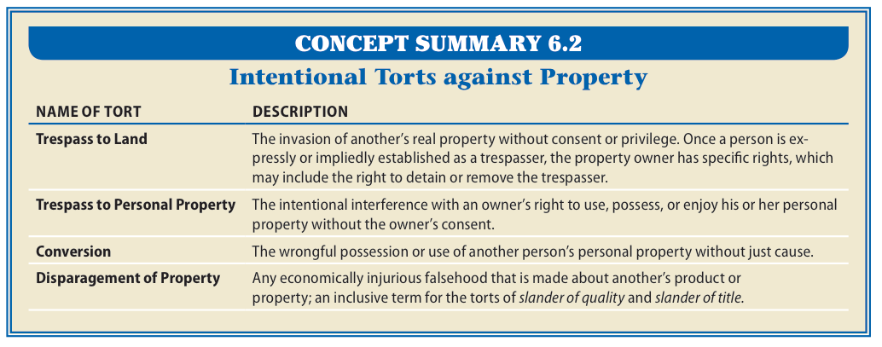
Intentional Torts Summary

Slide 35
§5: Negligence
Tortfeasor does not intend the consequences of the act or believes they will occur.
Actor’s conduct merely creates a foreseeable risk of injury. →

Slide 36
Negligence
Analysis:
Duty: Defendant owed Plaintiff a duty of care;
Breach: Defendant breached that duty;
Causation: Defendant’s breach caused the injury;
Damages: Plaintiff suffered legal injury.

Slide 37
Negligence
Duty of Care and Breach.
Defendant owes duty to protect Plaintiff from foreseeable risks that Defendant knew or should have known about.
A foreseeable risk is one in which the reasonable person would anticipate and guard against it. →

Slide 38
Negligence
Duty of Care and Breach.
Duty of Landowners.
Duty to warn invitees, exercise reasonable care.
Landlords owe duty of reasonable care to tenants and guests for common areas such as stairs and laundry rooms. →

Slide 39
Negligence
Duty of Care and Breach.
Duty of Landowners.
Duty to Warn Business Invitees of Foreseeable Risks (knew or should have known).
EXCEPTION: Obvious Risks.

Slide 40
Negligence
Duty of Care and Breach.
Duty of Professionals.
Professionals may owe higher duty of care based on special education, skill or intelligence.
Breach of duty is called professional malpractice.

Slide 41
Negligence
Causation.
Even though a Tortfeasor owes a duty of care and breaches the duty of care, the act must have caused the Plaintiff’s injuries. →

Slide 42
Negligence
Causation.
Courts ask two questions:
Was the defendant’s action the causation in fact of plaintiff’s injury, and →
Was it the proximate cause of plaintiff’s injury →.

Slide 43
Negligence
Causation in Fact. →
Did the injury occur because of the Defendant’s act, or would the injury have occurred anyway?
Usually determined by the “but for” test, i.e., but for the Defendant’s act the injury would not have occurred.

Slide 44
Negligence
Proximate Cause.
When the causal connection between the act and injury is strong enough to impose liability.
CASE 6.2 Palsgraf v. Long Island Railroad Co. (1928).

Slide 45
Negligence
The Injury Requirement and Damages.
To recover, Plaintiff must show legally recognizable injury.
Compensatory Damages are designed to reimburse Plaintiff for actual losses. →

Slide 46
Negligence
The Injury Requirement and Damages.
Punitive Damages are designed to punish the tortfeasor and deter others from wrongdoing.

Slide 47
Negligence
Negligence Per Se occurs when defendant violates a statute designed to protect plaintiff:
Statute sets out standard of care.
Plaintiff is member of class intended to be protected by statute.
Statute designed to prevent Plaintiff’s injury.

Slide 48
Negligence
Good Samaritan Statutes.
Protects someone who renders aid to an injured person from being sued for negligence.
Dram Shop Acts.
Liability for injuries may be imposed upon bartender and bar owner.

Slide 49
§6: Defenses to Negligence
Assumption of Risk. →
Superseding Intervening Cause→.
Contributory or Comparative Negligence.→

Slide 50
Defenses to Negligence
Assumption of Risk.
Plaintiff has knowledge of the risk, and voluntarily engages in the act anyway.
Defense can be used by participants, as well as spectators and bystanders. →

Slide 51
Defenses to Negligence
Assumption of Risk.
Can be implied by plaintiff’s knowledge of risks and subsequent conduct.
CASE 3.3 Taylor v. Baseball Club of Seattle, LP (2006).

Slide 52
Defenses to Negligence
Superseding Cause.
A unforeseeable, intervening act that breaks the causal link between Defendant’s act and Plaintiff’s injury, relieving Defendant of liability.

Slide 53
Defenses to Negligence
Contributory Negligence.
Under common law doctrine of contributory negligence, if plaintiff in any way caused his injury, he was barred from recovery.
Not very common.→

Slide 54
Defenses to Negligence
Comparative Negligence.
Most states have replaced contributory negligence with the doctrine of comparative negligence.→

Slide 55
Defenses to Negligence
Comparative Negligence.
Comparative negligence computes liability of Plaintiff and Defendant and apportions damages.
Pure Comparative Negligence States: allows Plaintiff to recover even if his liability is greater than that of Defendant. →

Slide 56
Defenses to Negligence
Comparative Negligence.
Modified Comparative Negligence States: percent of damages Plaintiff causes herself are subtracted from the total award. →

Slide 57
Defenses to Negligence
Comparative Negligence.
50 Percent Rule: Plaintiff recovers only if liability is less than 50%.
51 Percent Rule: Plaintiff recovers nothing if liability is greater than 50%.

