Slide 1
Chapter 18: Performance and Discharge in Traditional and E-Contracts
Miller

Slide 2
Introduction
A party may be discharged from a valid contract by:
A condition occurring -- or not occurring.
Full performance or material breach by the other party.
Agreement of the parties.
Operation of law.

Slide 3
§1: Conditions
A possible future event, the occurrence or nonoccurrence of which will trigger the performance of a legal obligation or terminate an existing obligation under a contract. →

Slide 4
Conditions
Precedent.
Condition that must be fulfilled before a party’s performance can be required.
Requires absolute duty to perform.
CASE 18.1 Pack 2000, Inc. v. Cushman (2011).

Slide 5
Conditions
Subsequent.
When a condition operates to terminate a party’s absolute promise to perform, after the time of absolute performance was due.
The Restatement refers to both precedent and subsequent as ‘conditions.’

Slide 6
Conditions
Concurrent.
When each party’s performance is conditioned on the other party’s performance or tender.
Both parties required to perform their duties simultaneously.

Slide 7
Conditions
Express and Implied.
Express conditions: provided in the parties’ agreement, usually preceded by words such as “If” or “Provided.”
Implied conditions: understood to be a part of the contract, depending on the purpose.

Slide 8
§2: Discharge by Performance
Both parties fulfill their respective duties by performing the acts they have promised.
Tender of performance: unconditional offer to perform.
Types of Performance→

Slide 9
Discharge by Performance
Complete Performance.
Parties perform exactly as agreed, or ‘perfect.’
All conditions satisfied.

Slide 10
Discharge by Performance
Substantial Performance.
Party in good faith performs substantially all of the terms, can enforce the contract.
Confers most of the benefits promised: performance must not vary greatly from what was promised. →

Slide 11
Discharge by Performance
Substantial Performance.
Omission or defect is unimportant, damages can be awarded.
Measure of damages is cost to bring object of contract into compliance. There is no exact formula.
CASE 18.2 Jacob & Youngs v. Kent (1921).

Slide 12
Discharge by Performance
Performance to the Satisfaction of Another.
Reasonable Person Standard: for most contracts, unless contract explicitly states third party approval.

Slide 13
Discharge by Performance
Material Breach of Contract.
Occurs when performance is not substantial.
Nonbreaching party is excused from performance and entitled to damages. →

Slide 14
Discharge by Performance
Non-Material Breach of Contract.
Duty to perform is not excused and the non-breaching party must resume performance of the contractual obligations undertaken.
CASE 18.3 Kohel v. Bergen Auto Enterprises, LLC (2013).

Slide 15
Discharge by Performance
Anticipatory Repudiation.
Before performance is due one party refuses to perform his or her contractual obligation.
Treated as a material breach, and nonbreaching party may sue for damages immediately, even though performance is not due.→

Slide 16
Discharge by Performance
Anticipatory Repudiation.
Notice by repudiating party may restore parties to original obligations.
Rational for Treating Repudiation as Breach.
Anticipatory Repudiation and Market Prices.

Slide 17
Discharge by Performance
Time for Performance.
If no time is stated in contract, reasonable time is implied.
If time is “of the essence” it becomes a condition precedent to performance.
Failure to complain may be a waiver.

Slide 18
§3: Discharge by Agreement
Discharge by Mutual Rescission.
If executory, parties must make a new contract, oral or written. Under UCC, however, contracts must be in writing.→

Slide 19
Discharge by Agreement
Discharge by Mutual Rescission.
If one party has performed, agreement to rescind must have additional consideration.

Slide 20
Discharge by Agreement
Discharge by Novation.
Both parties agree to substitute a new third party for one of the original parties. Requirements:
previous valid obligation,
agreement by all parties,
extinguishment of all old obligations, and
new valid contract.

Slide 21
Discharge by Agreement
By Settlement Agreement.
By Accord and Satisfaction.
Accord: contract to perform existing contractual duty not yet discharged.
Satisfaction: performance of accord.

Slide 22
§4: Discharge by Operation of Law
Material Alteration: innocent party is discharged after material alteration.
Statutes of Limitations.
Bankruptcy: generally bars enforcement of non-exempt transactions.

Slide 23
Discharge by Operation of Law
Impossibility of Performance.
Objective Impossibility of Performance: supervening event was not foreseeable.
When Performance is Impossible.
Death or Incapacitation in personal contract prior to performance, →

Slide 24
Discharge by Operation of Law
Impossibility of Performance.
When Performance is Impossible.
Destruction of the Subject Matter; or
Change in Law makes Contract Illegal.

Slide 25
Discharge by Operation of Law
Impossibility of Performance.
Temporary Impossibility.
Commercial Impracticability.
Performance becomes extremely difficult or costly, and not have been known by parties when contract made.

Slide 26
Discharge by Operation of Law
Frustration of Purpose.
Supervening event makes it impossible to attain purpose both parties had in mind.
Event must not have been foreseeable, and decreases value of what a party receives under contract.

Slide 27
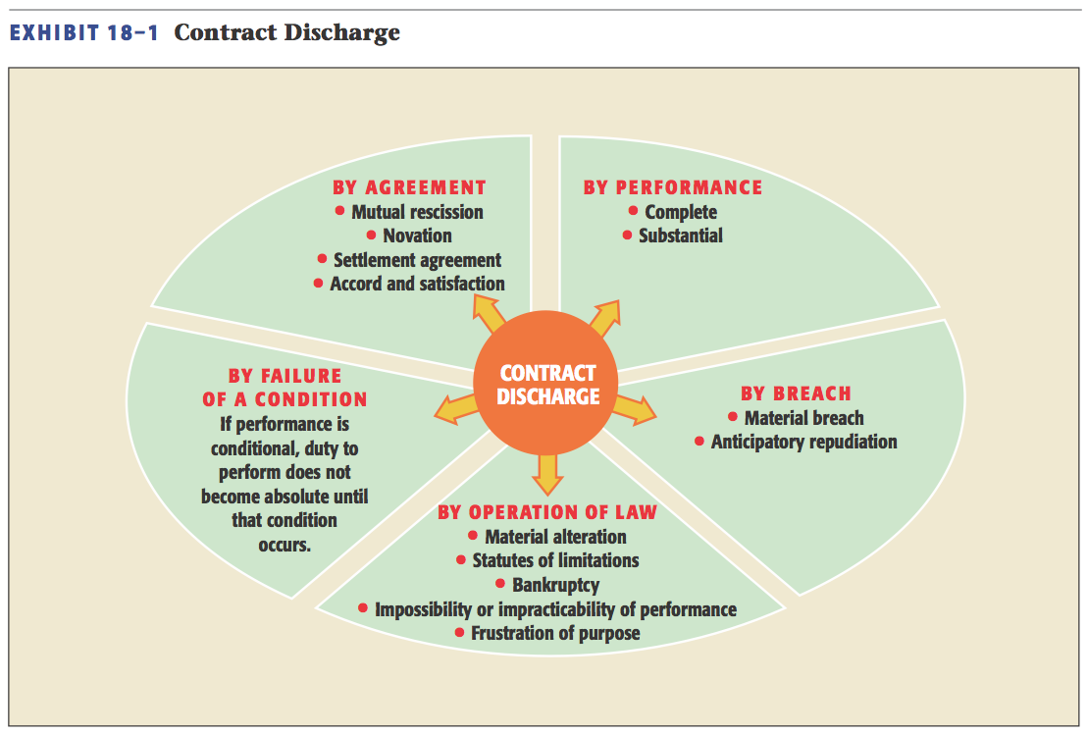
Contract Discharge

