Slide 1
Chapter 9: Internet Law, Social Media, and Privacy
Miller

Slide 2
§ 1: Internet Law
Spam: unsolicited “junk” emails with ads, solicitations, and other messages.
State Regulation of Spam.
Thirty-six states have legislation requiring an “opt out” of further email ads. →

Slide 3
Internet Law
Spam.
Federal CAN-SPAM Act.
U.S. Safe Web Act.
Allows FTC to share information with foreign agencies investigating and prosecuting cyber crimes. →

Slide 4
Internet Law
Spam.
U.S. Safe Web Act.
Provides ISP’s with immunity from liability for supplying subscriber information to FTC.

Slide 5
Internet Law
Domain Names. An internet address, consisting of:
A “top level domain” to the right of the “dot” (.com, .org, .edu) and
A “second level domain” to the left of the “dot” chosen by entity creating the domain name, e.g.,: www.cengage.com.

Slide 6
Internet Law
Domain Names.
Distribution System.
Internet Corporation for Assigned Names and Numbers (ICANN) overseas distribution of top-level domain names.
Overhauled its system to attempt to stop cybersquatting. →

Slide 7
Internet Law
Cybersquatting.
Anti-Cybersquatting Consumer Protection Act (1999) amended the Lanham Act.
Ongoing Problem of Cybersquatting. →

Slide 8
Internet Law
Cybersquatting.
Typocybersquatting.
Applicability and Sanctions of ACPA.
Meta Tags.
The Tabari’s and the Lexus.

Slide 9
Internet Law
Trademark Dilution in the Online World.
Does not require proof consumers would be confused.
CASE 9.1 Hasbro, Inc. v. Internet Entertainment Group, Ltd. (1996).

Slide 10
§ 2: Copyrights in Digital Information
Based on the Copyright Act of 1976.
Infringement may occur when a song (or any part of it) is copied or downloaded into a computer.

Slide 11
Copyrights in Digital Information
Digital Millennium Copyright Act.
Provides civil and criminal penalties to circumvent encryption software (like DVD).
Limits ISP liability for subscriber acts.
‘Fair Use’ Exceptions for Libraries, universities and others.

Slide 12
Copyrights in Digital Information
MP3 and File Sharing Technology.
Methods of File Sharing.
Peer to Peer (P2P) Networking.
Sharing Stored Music files (Napster, Kazaa, Gnutella) and vicarious liability.
“Cloud Computing.
CASE 9.2 Maverick Recording Co. v. Harper (2010).

Slide 13
Copyrights in Digital Information
MP3 and File Sharing Technology.
DVDs and File Sharing.
The U.S. Supreme Court has held that companies are vicariously liable when they distribute file-sharing software intending that it be used to violate copyright laws.
“TorrentSpy” owners order to pay $111 million.

Slide 14
§ 3: Social Media
Legal Issues.
Does infringement occur if a Facebook user posts copyrighted material? Is there a fair-use exception? What if the material is only for comment or discussion, not for profit? →

Slide 15
Social Media
Legal Issues.
Discovery in litigation almost always includes social media content.
Criminal Investigations.
Administrative Agencies.
CASE 9.3 In re O’Brien (2013).

Slide 16
Social Media
Legal Issues.
Employers’ Social Media Policies.
If employee violates company policy on social media (during work), the employee may be disciplined.

Slide 17
Social Media
Electronic Communications Privacy Act.
Prohibits interception of any wire, oral, or electronic communication.
Also prohibits the intentional disclosure of said information. →

Slide 18
Social Media
Electronic Communications Privacy Act.
Exclusions: what employer authorizes in the “ordinary course” of its business.
Stored Communications: prohibited, provides for both criminal and civil penalties.

Slide 19
Social Media
Protection of Social Media Passwords.
2013: four states have passed laws to protect users from disclosing passwords (including virtually any online storage – iTunes, icloud, etc).

Slide 20
Social Media
Company-Wide Social Media Networks.
Offered referred to as an ‘intranet’ these are online places for employees to discuss company services and products.
Intranets afford protection of Trade Secrets.

Slide 21
Social Media
Company-Wide Social Media Networks.
Offered referred to as an ‘intranet’ these are online places for employees to discuss company services and products.
Intranets afford protection of Trade Secrets.

Slide 22
§4: Online Defamation
Cyber torts arise on the internet.
Identifying the Author of Online Defamation.
Threshold barrier to suing an internet service provider (ISP). Suits are now brought by “John Does” until discovery is completed.→

Slide 23
Online Defamation
Liability of ISPs.
Communications Decency Act provides broad protection for ISPs, but there are limits to immunity.
General Rule: ISPs treated differently than publishers in defamation suits.→

Slide 24
Online Defamation
Liability of ISPs.
Exceptions: Roommate.com was ordered to pay $500,000 for invasive questions that prompted ‘discriminatory’ preferences.

Slide 25
§5: Privacy
Major social media and internet sites have been accused of violating users’ privacy rights.
But to prevail in an invasion of privacy lawsuit, the plaintiff must have had a reasonable expectation of privacy. →

Slide 26
Privacy
Does a plaintiff have a reasonable expectation of privacy on FaceBook?
Distinguish from online banking or credit card sites. →

Slide 27
Privacy
Data Collection and Cookies.
Does collection information on consumers violate any privacy right? Should retailers be allowed to “sell” that information to third parties?
What about “targeted advertising”?

Slide 28
Privacy
Internet Companies’ Privacy Policies.
FTC investigates consumer complaints.
The Consumer Privacy Bill of Rights. →

Slide 29
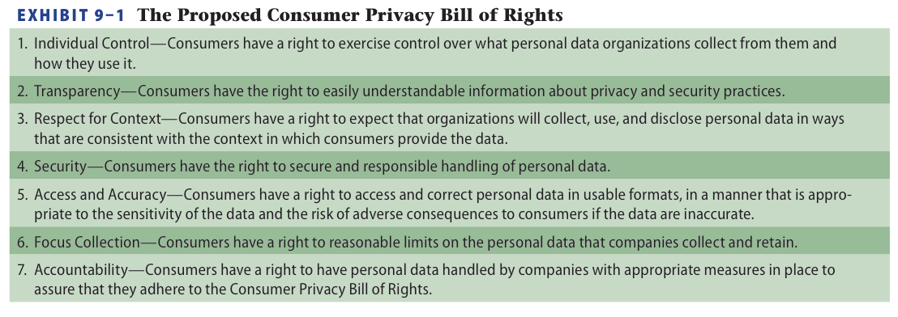
Consumer Privacy Bill of Rights

