Slide 1
Chapter 10: Criminal Law and Cyber Crime
Miller

Slide 2
§1: Civil and Criminal Law
Major Differences:

Slide 3
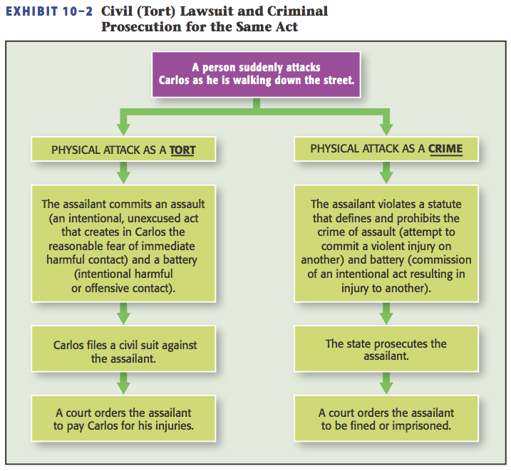
Civil and Criminal Law
Civil Liability for Criminal Acts.

Slide 4
Civil and Criminal Law
Classification of Crimes.
Felonies | Misdemeanors
Serious crimes, punishable by Death or prison for more than one (1) year. | Non-serious (petty) crimes punishable by jail for less than one(1) year and/or by fines.

Slide 5
§2: Criminal Liability
To be convicted of a crime, a person must:
Commit a guilty act (actus reus).
Have the guilty mind (mens rea) during commission of the guilty act. →

Slide 6
Criminal Liability
State of Mind.
Required intent (or mental state) is indicated in the applicable statute or law.
Criminal Negligence or Recklessness (unjustified, substantial and foreseeable risk that results in harm). →

Slide 7
Criminal Liability
State of Mind.
State of Mind: Strict Liability and Overcriminalization.
Federal code lists over 4,000 criminal offenses, many do not list a “mental state”.
Strict liability crimes are found in environmental, drug laws that affect public health, safety, and welfare.

Slide 8
Criminal Liability
Corporate Criminal Liability.
A corporation itself cannot be imprisoned but can be convicted of crime through acts of its officers.
Liability of the Corporate Entity. →

Slide 9
Criminal Liability
Corporate Criminal Liability.
Corporations may be convicted if:
Crime is within agent or employee’s scope of employment; or
Crime authorized or requested by corporate principal/officer. →

Slide 10
Criminal Liability
Corporate Criminal Liability.
Liability of Corporate Officers and Directors.
Corporate officers and directors are personally liable for crimes either they or their agents commit under the “responsible corporate officer” doctrine.

Slide 11
§3: Types of Crimes
Violent Crime.
Murder, sexual assault, rape, robbery.
Property Crime.
Burglary.
Larceny.→

Slide 12
Types of Crimes
Property Crime.
Larceny.
Obtaining Goods by False Pretenses.
CASE 10.1 People v. Whitmer (2013).
Receiving Stolen Goods.
Arson.
Forgery.

Slide 13
Types of Crimes
Public Order Crime.
White-Collar Crime.
Crimes occurring in the business context using non-violent means to obtain personal or business advantage.→

Slide 14
Types of Crimes
White-Collar Crime.
Embezzlement.
Mail and Wire Fraud (federal).
Bribery.
Bankruptcy Fraud (federal).
Insider Trading (federal).
Theft of Intellectual Property.

Slide 15
Types of Crimes
Organized Crime.
Operates illegitimately by providing illegal goods and services:
Money Laundering.
RICO(criminal and civil liability).

Slide 16
§4: Defenses to Criminal Liability
Justifiable Use of Force.
Self-Defense of People and Property can use deadly force if reasonable belief of imminent death or serious injury; cannot use deadly force to protect property alone.

Slide 17
Defenses
Necessity: criminal act necessary to prevent greater harm.
Insanity.
MPC
M’Naghten and Other State Rules. →

Slide 18
Defenses
Mistake.
Mistake of fact can excuse criminal act if it negates mental state.
Duress.
Wrongful threat induces another to commit a crime. →

Slide 19
Defenses
Entrapment: Key issue: was the defendant pre-disposed to commit the act?
Statute of Limitations.
Immunity.

Slide 20
§5: Criminal Procedures
U.S. Constitution provides specific safeguards for those accused of crimes at federal and state level.
Criminal procedures are designed to protect against the arbitrary use of power by the government. →

Slide 21
Criminal Procedures
Constitutional Protections.
Fourth Amendment.
Requirement that no warrant for a search or an arrest be issued without probable cause.
CASE 10.2 Messerschmidt v. Millender (2012).

Slide 22
Criminal Procedures
Constitutional Protections.
The Exclusionary Rule.
Evidence obtained in violation of the Fourth Amendment is excluded from trial.
“Fruit of the Poisonous Tree” is excluded as well.

Slide 23
Criminal Procedures
Constitutional Protections.
The Miranda Rule: based on the 1966 Miranda v. Arizona case.
CASE 10.3 Miranda v. Arizona (1966).
Exceptions: “public safety”, and an unequivocal demand for counsel.

Slide 24
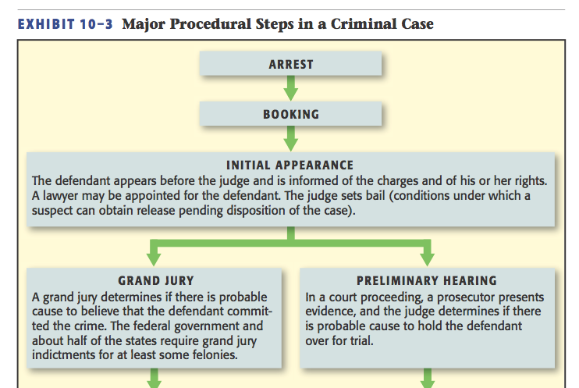
Criminal Process

Slide 25
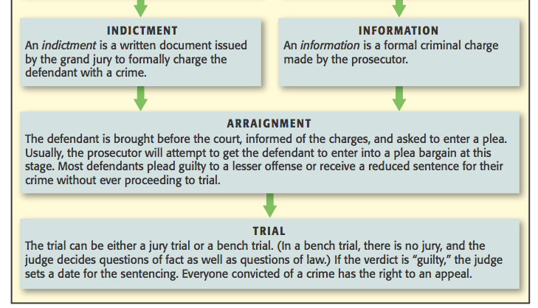
Criminal Process

Slide 26
Criminal Process
Class Discussion: is a defendant’s right to cross-examine a witness violated by two-way videoconferencing? →

Slide 27
Criminal Process
Federal Sentencing Guidelines.
Shift Away from Mandatory Sentencing.
Increased Penalties for Certain Crimes.

Slide 28
§6: Cyber Crime
Any act directed against computers or that uses computers as an instrumentality of a crime.
Cyber Fraud: fraud committed over the internet (e.g., Nigerian letter scam).

Slide 29
Cyber Crime
Cyber Theft.
Identity Theft.
Phishing.
Employment Fraud.
Credit-Card Numbers. →

Slide 30
Cyber Crime
Hacking.
Malware and Worms.
New Service-Based Hacking Available at Low Cost.
Cyber Terrorism. →

Slide 31
Cyber Crime
Prosecuting Cyber Crime.
“Location” of crime (jurisdiction) is an issue.
Computer Fraud and Abuse Act.
Person is liable if he accesses a computer online, without authority, to obtain classified, private, or protected information. Penalties include fines and imprisonment.

