Slide 1
Chapter 12: Contracts – Agreement in Traditional and E-Contracts
Miller

Slide 2
§1: Agreement
Agreement = offer and acceptance.
Parties must show mutual assent to terms of contract.
Once an agreement is reached, if the other elements of a contract are present, a valid contract is formed.

Slide 3
Agreement: Offer
Requirements of the Offer.
Offeror’s Serious Intention. →
Definiteness of Terms. →
Communication to Offeree. →

Slide 4
Agreement: Offer
Offeror’s Serious Intention.
Contract is judged by what a reasonable person in the Offeree’s position would conclude about the offer. →
CASE 12.1 Lucy v. Zehmer (1954). →

Slide 5
Agreement: Offer
Where Intent May Be Lacking.
Expressions of Opinion: not offers.
Statements of Future Intent: not offers.
Preliminary Negotiations, or Invitations to Negotiate: not offers. →

Slide 6
Agreement: Offer
Where Intent May Be Lacking.
Advertisements: not offers (invitations to negotiate).
Auctions.
Not an offer, but invitation for offers through an auctioneer.→

Slide 7
Agreement: Offer
Where Intent May Be Lacking.
Auctions.
Auctions With and Without Reserve.
With Reserve: can withdraw goods.
Without Reserve: cannot withdraw goods.

Slide 8
Agreement: Offer
Where Intent May Be Lacking.
Agreements to Agree.
Preliminary Agreements.
CASE 12.3 Basis Technology Corp. v. Amazon.com, Inc. (2008).

Slide 9
Agreement: Offer
Definiteness of Terms.
Identification of the parties.
Object or subject matter of the contract.
Consideration to be paid.
Time of payment, Delivery, or Performance. →

Slide 10
Agreement: Offer
Definiteness of Terms.
An offer can require specific terms to make the contract definite.
A court can supply missing terms if the parties intend to form a contract.

Slide 11
Agreement: Offer
Communication.
Offeree’s knowledge of the offer:
Directly by the Offeror, or
Use of Agents.
CASE 12.3 Gyabaah v. Rivlab Transportation Co. (2013).

Slide 12
Agreement: Offer
Termination of Offer.
An offer may be terminated prior to acceptance by either:
Action of the Parties →
or by
Operation of Law. →

Slide 13
Agreement: Offer
Termination By Action of Parties.
Revocation of the Offer by the Offeror:
Offer can be withdrawn anytime before Offeree accepts the offer.
Effective when the Offeree or Offeree’s agent receives it. →

Slide 14
Agreement: Offer
Termination By Action of Parties.
Irrevocable Offers. Courts are generally unwilling to allow revocation when offeree has changed position based on justifiable reliance on the offer.→

Slide 15
Agreement: Offer
Termination By Action of Parties.
Option Contract: Promise to hold an offer open for a specified period of time in return of consideration.

Slide 16
Agreement: Offer
Termination By Action of Parties.
Rejection of the Offer by the Offeree:
Rejection by the Offeree (expressed or implied) terminates the offer.
Effective only when it is received by the Offeror or Offeror’s agent.

Slide 17
Agreement: Offer
Termination By Action of Parties.
Counteroffer by the Offeree.
Rejection of original offer and the simultaneous making of a new offer.
Mirror Image Rule: At common law, any change in terms automatically terminates the offer and substitutes the counteroffer.

Slide 18
Agreement: Offer
Termination By Operation of Law.
Lapse of Time.
Offer terminates by law when the period of time specified in the offer has passed.
If no time period for acceptance is specified, the offer terminates at the end of a reasonable period of time.→

Slide 19
Agreement: Offer
Termination By Operation of Law.
Destruction of the Subject Matter: if it occurs before acceptance of the offer, then the offer is canceled.→

Slide 20
Agreement: Offer
Termination By Operation of Law.
Death or Incompetence of the Offeror or Offeree: automatically terminates unless it is an irrevocable offer.→

Slide 21
Agreement: Offer
Termination By Operation of Law.
Supervening Illegality of the Proposed Contract: legislation or court decision automatically terminates offer or renders contract unenforceable.

Slide 22
Agreement: Acceptance
Acceptance is the:
Voluntary act (expressed or implied),
by the Offeree that,
shows assent (agreement),
to the terms of an offer. →

Slide 23
Agreement: Acceptance
Unequivocal Acceptance: The “Mirror Image” Rule.
Silence as Acceptance.
General Rule: offeree should not be legally obligated to affirmatively reject an offer. →

Slide 24
Agreement: Acceptance
Silence as Acceptance.
When Offeree Has Duty to Speak:
He takes benefit of services with opportunity to reject.
Prior dealings with Offeror.

Slide 25
Agreement: Acceptance
Communication of Acceptance.
Bilateral Contract: Communication of acceptance is necessary because of mutual exchange of promises.
Not necessary if offer does not require.→

Slide 26
Agreement: Acceptance
Communication of Acceptance.
Unilateral Contract: acceptance is evident, notification not necessary.

Slide 27
Agreement: Acceptance
Mode and Timeliness.
General Rule: in bilateral contracts, acceptance is timely if made before offer is terminated. →

Slide 28
Agreement: Acceptance
Mode and Timeliness.
Mailbox Rule: acceptance is effective when offeree uses authorized means of acceptance.
If U.S. Mail, acceptance upon dispatch.
Does not apply to instantaneous communications (UETA may apply).→

Slide 29
Agreement: Acceptance
Mode and Timeliness.
Authorized Means of Acceptance: offer specifies (expressly or impliedly) how acceptance should be made.
No acceptance if authorized means is not used.

Slide 30
Agreement: Acceptance
Mode and Timeliness.
Substitute Method of Acceptance.
Effective if the substitute serves the same purpose (Fed-Ex vs. UPS).
Not effective on dispatch.
Effective when received by the Offeror.

Slide 31
§2: Agreement in E-Contracts
Online Offers.
Displaying the Offer. Seller’s website should include hyperlink to page with full contract.
Provisions to Include. →

Slide 32
Agreement in E-Contracts
Online Offers: Provisions.
Acceptance of Terms: what constitutes an acceptance.
Payment: how payment is made.
Return Policy.
Disclaimer: of liability for certain uses of the goods.

Slide 33
Agreement in E-Contracts
Online Offers: Provisions.
Limitations on Remedies: if goods defective or contract is breached.
Privacy Policy.
Dispute Resolution: usually arbitration or forum-selection clauses. →

Slide 34
Agreement in E-Contracts
Dispute Settlement Provisions.
Forum-Selection Clause: location or jurisdiction where disputes will be resolved.
Choice-of-Law Clause: disputes will be settled in accordance with law of particular jurisdiction.

Slide 35
Agreement in E-Contracts
Online Acceptances.
Click-On Agreements.
A binding contract can be formed by clicking on a box indicating “I Accept” or “I Agree.” Contract can be formed via website or software.
Law does not require parties read all the terms.

Slide 36
Agreement in E-Contracts
Online Acceptances.
Shrink-Wrap Agreements.
Contract terms are inside the box.
Party opening box agrees to terms by keeping merchandise.
Enforceable vs. Unenforceable Terms.

Slide 37
Agreement in E-Contracts
Online Acceptances.
Browse-Wrap Agreements.
Like click-on agreements, browse-wrap terms can occur in transactions over internet.
Unlike click-on agreements, browse-wrap terms do not require assent and are usually unenforceable.

Slide 38
E-Signature Technologies
E-Signature: electronic sound, symbol, or process attached to or logically associated with a record and executed or adopted by a person with the intent to sign the record.
Digitized Signature: graphical image of a handwritten signature.

Slide 39
E-Signature Technologies
Federal Law.
E-SIGN (2000) gives e-signatures and e-documents legal force.
For an e-signature to be enforceable, the contracting parties must have agreed to use electronic signatures. →

Slide 40
E-Signature Technologies
Federal Law.
E-SIGN does not apply to all documents. Examples: court documents, divorce decrees, pre-nuptials, and wills.

Slide 41
Agreement in E-Contracts
Partnering Agreements.
Sellers and Buyers agree as to protocols to create online agreements.
Useful for electronic inventory (Just In Time) ordering of parts and supplies.

Slide 42
§ 3: The Uniform Electronic Transactions Act
Purpose is to remove barriers to forming electronic contracts.
E-Signature is “electronic sound, symbol or process…associated with a record and… adopted by a person with intent to sign the record.” →

Slide 43
The Uniform Electronic Transactions Act
A record is information that is inscribed on a tangible medium or stored in electronic or other medium that is retrievable in visual form.

Slide 44
The Uniform Electronic Transactions Act
Scope and Applicability.
UETA does not create new rules, but rather enforces ‘real world’ rules on electronic contracts.→

Slide 45
The Uniform Electronic Transactions Act
Scope and Applicability.
Only applies to e-records and e-signatures relating to a “transaction” (interactions between two people relating to business, commercial, or governmental activities).

Slide 46
The Uniform Electronic Transactions Act
Scope and Applicability.
UETA does not apply to wills or testamentary trusts.
Does not apply unless each party has previously agreed to conduct electronic transactions.
Can be implied by conduct.

Slide 47
The Uniform Electronic Transactions Act
Federal E-SIGN and UETA.
E-SIGN explicitly refers to UETA and provides that E-SIGN is pre-empted by state passing of UETA.
But state law must conform to minimum E-SIGN procedures.

Slide 48
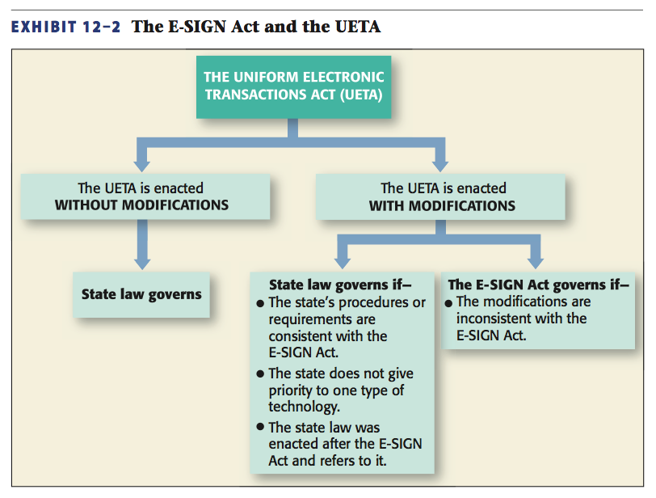
E-SIGN and UETA

Slide 49
The Uniform Electronic Transactions Act
Signatures on E-Records.
If electronic record or signature is act of a particular person, the record or signature is attributed to that person.
However, state law governs issues of agency, authority, forgery, contract formation.

Slide 50
The Uniform Electronic Transactions Act
Effect of Errors: prompt notification.
Timing: “E-Mailbox” Rules.
Dispatched when leaves control of sender.
Received when enters recipient’s processing system (even if unaware).

Slide 51
§ 4: International Treaties Affecting E-Contracts
United Nations Convention on the Use of Electronic Communications in International Contracts (2005). →

Slide 52
International Treaties Affecting E-Contracts
Hague Convention on the Choice of Court Agreements: provides certainty on jurisdiction and enforcement.

