Slide 1
Chapter 14: Contracts – Capacity and Legality
Miller

Slide 2
§1: Contractual Capacity
Contractual Capacity.
Legal ability to enter into a contractual relationship.
A person determined by court to be mentally incompetent cannot form a valid contract. →

Slide 3
Contractual Capacity
Contractual Capacity.
In other situations, capacity may exist, but contract is not legally binding.

Slide 4
Contractual Capacity
Minors.
Generally, at 18 years, a person is emancipated, and has the legal capacity to enter into any contract that an adult can.
However, a contract entered into by a minor is voidable at the option of that minor, and can be disaffirmed. →

Slide 5
Contractual Capacity
Minors—Disaffirmance.
Contract can be disaffirmed at any time during minority, or for a reasonable period after minor is emancipated. →

Slide 6
Contractual Capacity
Minors—Disaffirmance.
Minor must disaffirm the entire contract.
Disaffirmance can be expressed or implied.→

Slide 7
Contractual Capacity
Minors—Disaffirmance.
Majority Rule: minor need only return the goods (or other consideration) subject to the contract, provided the goods are in the minor’s possession or control.→

Slide 8
Contractual Capacity
Minors—Disaffirmance.
Minority Rule: increasing number of states hold the minor must restore the adult to the position held before the contract was made.

Slide 9
Contractual Capacity
Minors—Disaffirmance.
Exceptions: Misrepresentation of Age.
Generally, minor can disaffirm the contract.
But some states prohibit disaffirmance and hold the minor liable.

Slide 10
Contractual Capacity
Minors—Disaffirmance.
Exceptions: Necessaries.
Contracts for food, clothing, shelter may be disaffirmed by minor, who remains liable for the reasonable value of goods or services.

Slide 11
Contractual Capacity
Minors—Disaffirmance.
Exceptions: Necessaries.
Ratification: occurs when a minor, on or after reaching majority, indicates (expressly or impliedly) an intention to become bound by a contract made as a minor.
Parents’ Liability: Parents generally not liable, unless they co-sign with minor.

Slide 12
Contractual Capacity
Intoxication.
Lack of capacity at the time the contract is being made. Contract is either voidable or valid, depending on circumstances.
Disaffirmance (voidable).
Ratification: after ‘sobering up.’

Slide 13
Contractual Capacity
Mental Incompetence.
Void: If a person has been adjudged mentally incompetent by a court of law and a guardian has been appointed.→

Slide 14
Contractual Capacity
Mental Incompetence.
Voidable: If the person does not know he or she is entering into the contract or lacks the mental capacity to comprehend its nature, purpose, and consequences.

Slide 15
Contractual Capacity
Mental Incompetence.
Valid: when person is able to understand the nature and effect of entering into a contract but may lack capacity to engage in other activities (known as “lucid” intervals).

Slide 16
§2: Legality
For a contract to be enforceable, it must be formed for a legal purpose.
A specific clause in contract can be illegal, but rest of contract can be enforceable.
A contract to commit a tortious act is illegal (see Chapter 6).

Slide 17
Legality
Contracts Contrary to Statute.
Contracts to do something prohibited by federal or state statutory law is illegal and therefore void (never existed).
Contracts to Commit a Crime.
Contracts for Usury.

Slide 18
Legality
Contracts Contrary to Statute.
Gambling: distribution of property based on chance among persons who have paid valuable consideration.→

Slide 19
Legality
Contracts Contrary to Statute.
Licensing Statutes: contract’s enforceability depends on its purpose.
CASE 14.1 Sturdza v. United Arab Emirates (2011).

Slide 20
Legality
Contracts Contrary to Public Policy.
Generally, VOID.
Contracts in Restraint of Trade are generally void.
Exception: Covenant not to Compete and Sale of an Ongoing Business. →

Slide 21
Legality
Contracts in Restraint of Trade.
Covenant Not to Compete in Employment is enforceable as long as time and geographic terms are reasonable.
CASE 14.2 Comedy Club, Inc. v. Improv West Associates (2009).

Slide 22
Legality
Unconscionable Contracts or Clauses.
Procedural Unconscionability: inconspicuous print or legalese.
Depends on a party’s lack of knowledge or expertise. →

Slide 23
Legality
Unconscionable Contracts or Clauses.
Substantive Unconscionability: contracts are oppressive or overly harsh; that deny a remedy for nonperformance.

Slide 24
Unconscionability

Slide 25
Legality
Exculpatory Clauses.
Release a party from liability in the event of monetary or physical injury – no matter who is at fault. →

Slide 26
Legality
Exculpatory Clauses.
Enforceable when they are not against public policy, are not ambiguous, and do not shield parties from intentional conduct.
CASE 14.3 Holmes v. Multimedia KSDK, Inc. (2103).

Slide 27
Legality
Discriminatory Contracts.
Party promises to discriminate on the basis of race, color, national origin, religion, gender, age, or disability are contrary to both statute and public policy, and unenforceable.

Slide 28
Legality
Effect of Legality.
Generally, illegal contracts are void.
If contract is executory, cannot be enforced.
Unjust enrichment is not an issue.→

Slide 29
Legality
Effect of Legality.
Exceptions to Void:
Justifiable Ignorance of the Facts.
Members of Protected Classes.
Withdrawal from an Illegal Agreement.→

Slide 30
Legality
Effect of Legality.
Exceptions to Void:
Contract Illegal through Fraud, Duress, or Undue Influence.
Severable or Divisible Contracts.

Slide 31
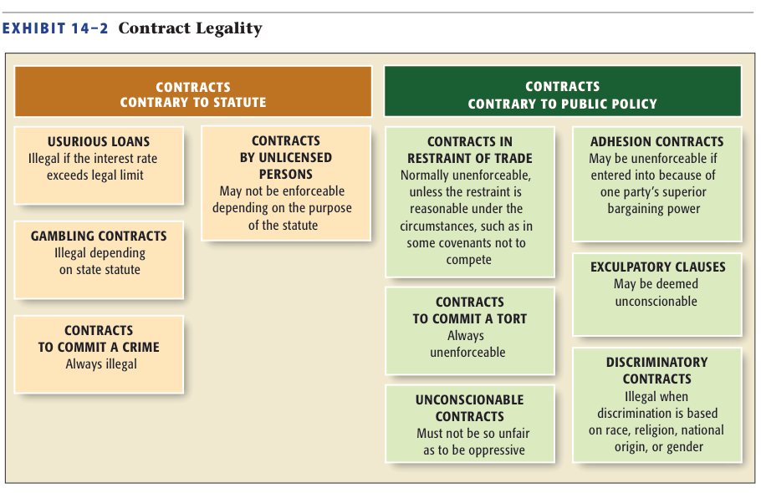
Legality

