Slide 1
Chapter 15: Contracts – Mistakes, Fraud, and Voluntary Consent
Miller

Slide 2
Introduction
Contract may be unenforceable if the parties have not genuinely assented to its terms by:
Mistake.
Misrepresentation.
Undue Influence.
Duress.

Slide 3
§1: Mistakes
Only a Mistake of Fact allows a contract to be canceled.
Unilateral Mistakes cannot be canceled unless:
If other party to the contract knows or should have known that a mistake of fact was made, OR →

Slide 4
Mistakes
Unilateral Mistakes cannot be canceled unless:
If mistake was due to an inadvertent mathematical and without gross negligence.

Slide 5
Mistakes
Bilateral (Mutual) Mistakes can be rescinded by either party.
CASE 15.1 L & H Construction Co. v. Circle Redmont, Inc. (2011).

Slide 6
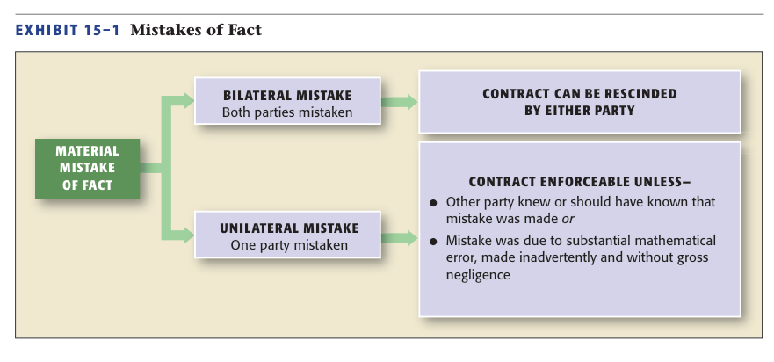
Mistakes of Fact

Slide 7
Mistakes
Mistake of Value.
Generally, contract is enforceable by either party.
Exception: Mistake of value because of a mistake of material fact.

Slide 8
§2: Fraudulent Misrepresentation
Contract is Voidable by Innocent Party.
Consists of the following Elements:
Misrepresentation of Material Fact.
Intent to Deceive.
Reliance on Misrepresentation.
Injury to the Innocent Party.

Slide 9
Fraudulent Misrepresentation
Misrepresentation by Conduct: occurs when a party takes specific action to conceal a fact that is material to the contract.→

Slide 10
Fraudulent Misrepresentation
Statement of Fact vs. Statement of Opinion.
Statement of Opinions are not actionable.
Opinions from Experts can be actionable, and injured party can seek rescission or reformation. →

Slide 11
Fraudulent Misrepresentation
Misrepresentation of Law: does not entitle a party to relief.
Misrepresentation by Silence.
Ordinarily neither party has duty to disclose facts. →

Slide 12
Fraudulent Misrepresentation
Misrepresentation by Silence.→
However, seller will be liable if she knows of material defect that cannot be reasonably discovered by buyer.
CASE 15.2 Fazio v. Cypress/GR Houston I, LP (2012).

Slide 13
Fraudulent Misrepresentation
Misrepresentation by Silence.→
When parties are in a fiduciary relationship, failure to disclose material facts may be fraud.

Slide 14
Fraudulent Misrepresentation
Intent to Deceive.
Scienter (Guilty Knowledge) is an Intent to Deceive.
Party knows that a ‘fact’ is not true, or makes a reckless statement without regard for the truth, or implies that statement is based on personal knowledge or investigation.

Slide 15
Intent to Deceive
Innocent Misrepresentation: person makes statement he believes to be true but actually misrepresents facts.
Innocent party can rescind contract, but usually cannot seek damages.→

Slide 16
Intent to Deceive
Reliance on Misrepresentation.
Deceived party must have justifiably relied on representation.
Reliance is not justified if the innocent party knows the true facts or relies on extravagant statements.
CASE 15.3 Cronkelton v. Guaranteed Construction Services, LLC (2013).

Slide 17
Intent to Deceive
Injury to the Innocent Party.
No proof of injury is required when the action is to rescind contract.
Proof of injury is universally required to recover damages.

Slide 18
§3: Undue Influence
Contract lacks voluntary consent and is voidable.
Based on Confidential or Fiduciary Relationship, or Relationship of Dependence.→

Slide 19
Undue Influence
Contract lacks voluntary consent and is voidable.
Undue Influence or Persuasion is presumed if weak party talked into doing something not beneficial to him or herself.

Slide 20
§4: Duress
Party who enters into a contract under fear or threat makes the contract voidable.
Threatened act must be wrongful or illegal and render person incapable of exercising free will.
Threat of civil suit is not unlawful.

Slide 21
Duress
Economic Duress: generally not sufficient to constitute duress, unless same party who created the need also requires the money.

Slide 22
§5: Adhesion Contracts and Unconscionability
Standard-Form (Adhesion) Contracts.
Preprinted contract in which the adhering party has no opportunity to negotiate the terms of the contract.→

Slide 23
Adhesion Contracts and Unconscionability
Standard-Form (Adhesion) Contracts.
One-sided “Take-it-or-Leave-it” contracts where one side has substantially superior bargaining power.

Slide 24
Adhesion Contracts and Unconscionability
Unconscionability and the Courts.
Under UCC unconscionability only applies to sale of goods.
But courts have broadened scope to include other situations.

Slide 25
