Slide 1
Chapter 16: Contracts – The Writing Requirement and Electronic Records
Miller

Slide 2
§1: Writing Requirement: Statute of Frauds
Origins.
In 1677 England passed the law “An Act for the Prevention of Frauds and Abuses.” Required that, to be enforceable, certain types of contracts must be in writing and signed by the party against whom enforcement is sought to be enforceable. →

Slide 3
Writing Requirement: Statute of Frauds
State Legislation.
Today, virtually every state has, with minor variations, a Statute of Frauds provision.
The primary purpose of the SOF is to prevent harm to innocent parties by requiring written evidence of agreements.

Slide 4
§2: Contracts That Require a Writing
To be enforceable, the following types of contracts must be in writing and signed:
1. Contracts involving Interest in Land.
2. Contracts involving “One-Year Rule.”
3. Collateral or Secondary Contracts. →

Slide 5
Contracts That Require a Writing
To be enforceable, the following types of contracts must be in writing and signed:
4. Promise Made in Consideration of Marriage.
5. Contracts for the Sale of Goods priced at $500 or more.

Slide 6
Contracts That Require a Writing
To be enforceable, the following types of contracts must be in writing and signed:
4. Promise Made in Consideration of Marriage.
5. Contracts for the Sale of Goods priced at $500 or more.

Slide 7
Contracts That Require a Writing
Contracts Involving Interests in Land.
Must be in writing, signed.
SOF operates as a defense to enforcement of oral contract.
CASE 16.1 Salim v. Solaiman (2010).

Slide 8
Contracts That Require a Writing
The One-Year Rule.
A contract that cannot, by its own terms, be performed within one year from the date it was formed.
Test: Objective impossibility. Whether performance is possible (although unlikely) within one year.

Slide 9
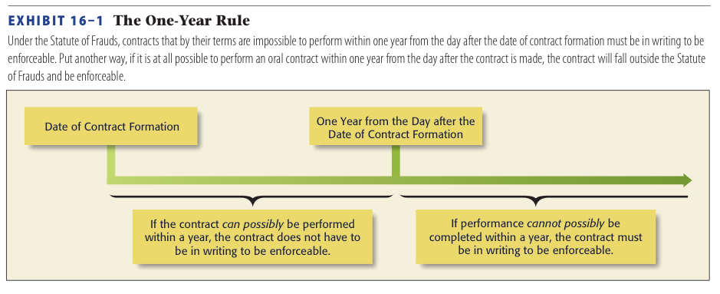
One Year Rule

Slide 10
Contracts That Require a Writing
Collateral Promises.
Secondary promise made to a third party to assume the debts and obligations of the primary debtor.→

Slide 11
Contracts That Require a Writing
Collateral Promises.
Primary v. Secondary Obligations.
Primary contract does not need to be in writing.
Secondary contract must be in writing to be enforceable.

Slide 12
Contracts That Require a Writing
Collateral Promises.
Exception--“Main Purpose Rule”: oral contract is enforceable if main purpose is benefit to guarantor.

Slide 13
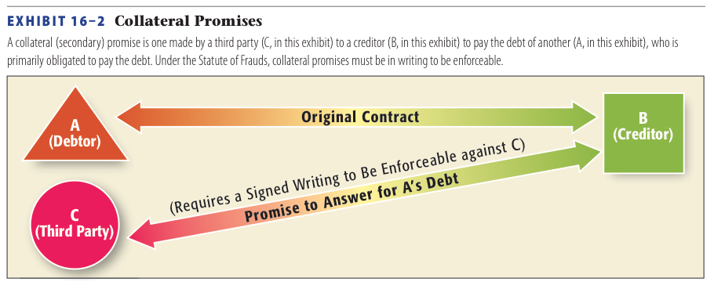
Collateral Promises

Slide 14
Contracts That Require a Writing
Promises Made in Consideration of Marriage.
A unilateral promise to make monetary payment or gift in consideration of a promise to marry must be in writing.
Same applies to prenups.

Slide 15
Contracts That Require a Writing
Contracts for the Sale of Goods.
UCC requires a writing or memorandum for the sale of goods priced at $500 or more.
Must be ‘signed’ by party against whom enforcement is sought.

Slide 16
§3: Exceptions to the Writing Requirement
Partial Performance.
Court will grant specific performance if partially performed.
CASE 16.2 NYKCool A.B. v. Pacific Fruit, Inc. (2013).

Slide 17
Exceptions to the Writing Requirement
Admissions.
Promissory Estoppel.
Special Exceptions under the UCC.
Oral contracts for custom goods.

Slide 18
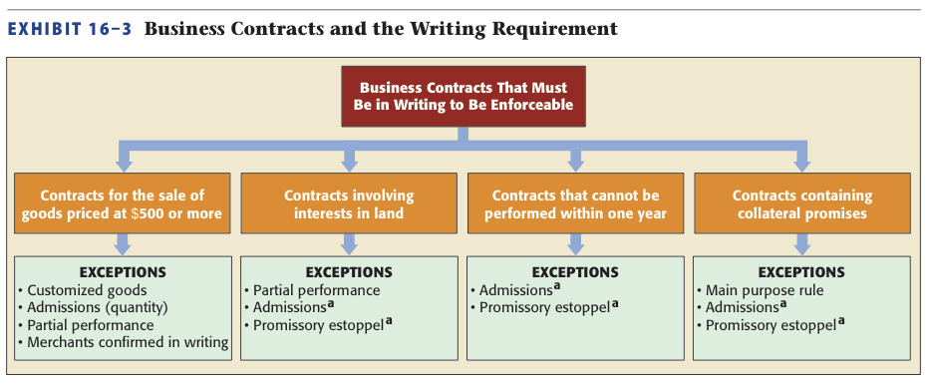
Business Contracts and the Writing Requirement

Slide 19
§4: Sufficiency of the Writing
Statute of Frauds requires a ‘Written Memorandum’ (written or electronic) signed by the party against whom enforcement is sought.
What Constitutes a Writing?

Slide 20
Sufficiency of the Writing
Statute of Frauds requires a ‘Written Memorandum’ (written or electronic) signed by the party against whom enforcement is sought.
What Constitutes a Writing?

Slide 21
Sufficiency of the Writing
What Must Be Contained in the Writing?
The essential terms: quantity, signed by party to be charged, names of parties, subject matter, consideration. Sales of land must state the price and description with sufficient clarity. →

Slide 22
Sufficiency of the Writing
What Must Be Contained in the Writing?
Faxed memo sufficient if it shows a meeting of the minds.
CASE 16.3 Beneficial Homeowner Service Corp. v. Steele (2011).

Slide 23
§5: The Parol Evidence Rule
Oral representations or promises made prior to the contract’s formation or at the time the contract was created, may not be admitted in court.
Exceptions. →

Slide 24
The Parol Evidence Rule
Exceptions.
1. Contracts subsequently modified.
2. Voidable or Void contracts.
3. Contracts containing ambiguous terms.
4. Incomplete Contracts.→

Slide 25
The Parol Evidence Rule
Exceptions.
4. Prior dealing, course of performance, usage of trade.
5. Contracts subject to orally agreed-on conditions precedent.
6. Contracts with an obvious or gross clerical error.

Slide 26
The Parol Evidence Rule
Integrated Contracts.
Can be either complete or partially integrated.
Complete: a “four corner” contract that is complete. All extraneous evidence is excluded.

Slide 27
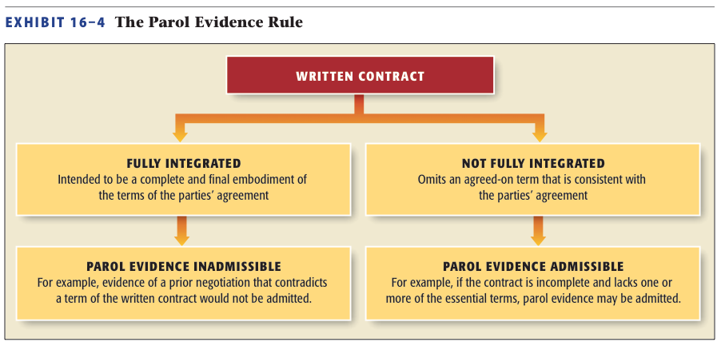
The Parol Evidence Rule

Slide 28
§6: The Statute of Frauds in the International Context
CISG governs sales contracts. Article 11 does not incorporate statute of frauds provisions.
Relies on the accord of legal customs of most countries.

